Slide 1
Endocrine Control Systems
Notes:
Talk about
+ Changes in lecture order
+ Changes in learning objectives
+ Lecture notes vs slides
+ Mention clicker quizes

Slide 2
Next Few Lectures
Today
Endocrine Control Systems
Posterior Pituitary
Thursday
Adrenal Gland and Stress Hormones
Endocrine Control of Growth
Next Tuesday
Pancreas and Glucoregulation
Regulation of Appetite
April 14th: Clinical Case in Textbook + Review
April 18th: Exam on this Unit
Includes material from Fan, Parthasarathi and Parfenova Lectures

Slide 3
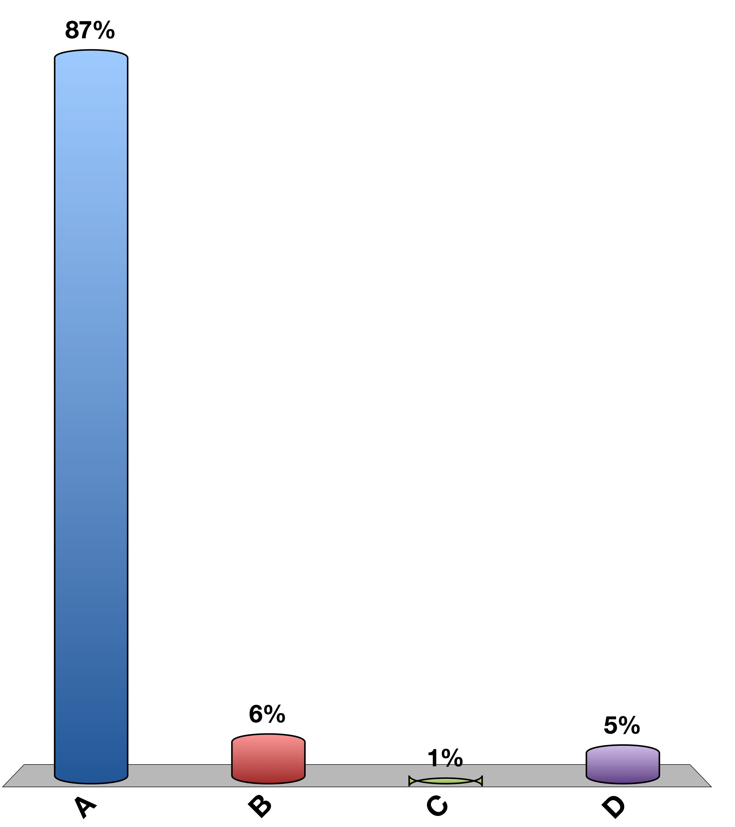
Clicker Test: Press “A”
A
B
C
D

Slide 4
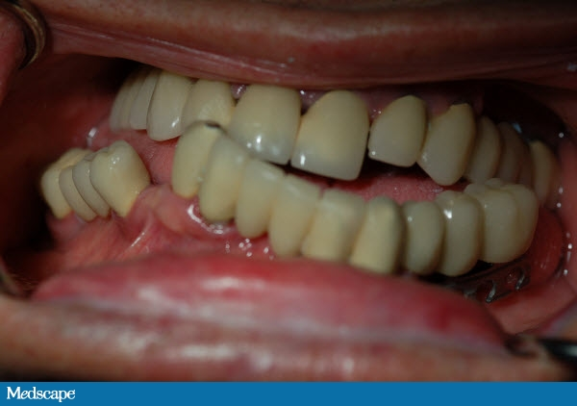
Why should a dentist (or a doctoral student) care about endocrinology
Diabetes (Insulin Insufficiency/Resistance)
Periodontitis
Mucusal disease
Altered taste
Parotid gland enlargent
Potential hypo/hyperglycemia
Hypoparathyroidism (Not Enough PTH)
Low calcium density, hypoplasia of enamel and dentin
Candidiasis
Delayed eruption, shortened roots
Hyperthyroidism (T3/T4 Overproduction)
Malocclusion
Demineralization
Anxiety/restlessness
Acromegaly (GH Overproduction)
Accelerated tooth eruption
Enlarged jaw, abberant tooth spacing
Cushing’s (Cortisol Overproduction)
Periodontis, swelling of gums
Easy bruising
Addison’s Disease (Cortisol Insufficiency)
Blotchy melanin patches in oral mucosa

Slide 5
Learning Objectives
Define endocrine, paracrine, autocrine, and exocrine systems, define neuro-secretory cells by giving a few examples.
List major chemical categories of hormones and give several examples that belong to each class.
List important factors that determine hormone levels in circulation.
Explain cellular actions of hormones via membrane and nuclear receptors, including an understanding of the rates by which these processes can affect cells.
Define basal secretion and stimulated secretion of endocrine glands.
Describe negative and positive feedback system using an example.
Explain with examples neuroendocrine integration.

Slide 6
Things you (should) already know
Regulation of renal function (Tigyi)
Renin/Angiotensin/Aldosterone/ANF/Vasopressin
Regulation of GI function (Johnson)
Gastrin/CCK/GIP/Secretin/VIP/Motilin
Blood Pressure Regulation (O’Connell)
Angiotensin/Vasporessin/Adrenaline/Noradrenaline/Dopamine/Endothelin
Cardiac Function (Mancarella)
ANP/Adrenaline/Noradrenaline/Acetylcholine
Synaptic Transmission (Adebiyi)
Serotonin/Acetylcholine/GABA/Histamine/Aspartate/Glutamate/NO
Notes:
Mention how the upcoming clicker quizes are mostly to determine how much you remember

Slide 7
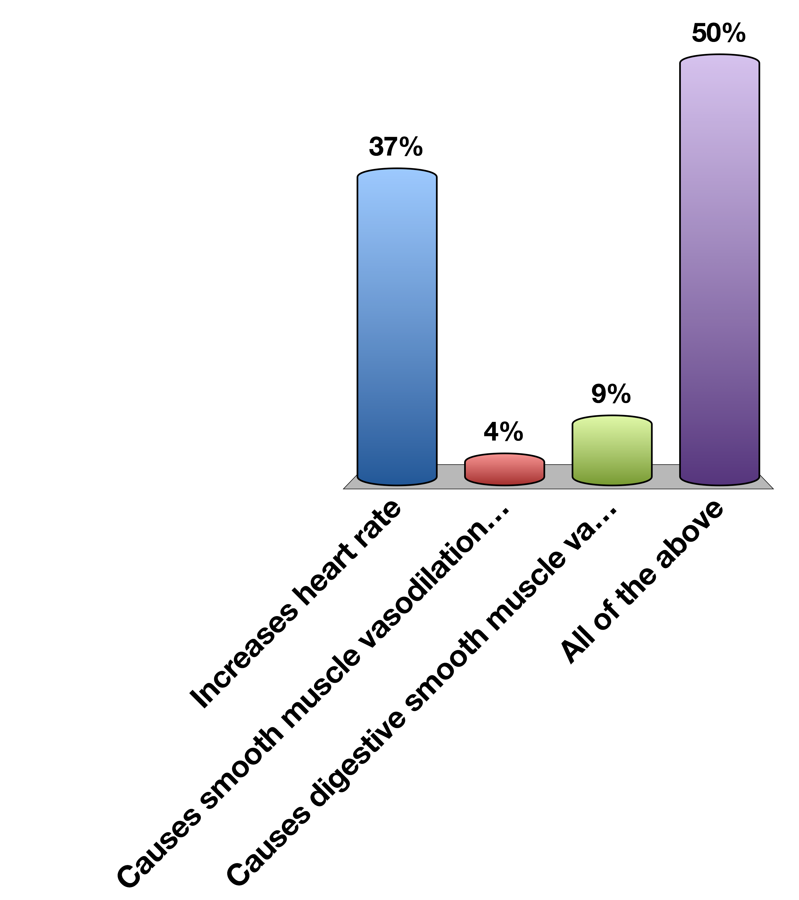
Epinephrine…
Increases heart rate
Causes smooth muscle vasodilation in skeletal muscle
Causes digestive smooth muscle vasoconstriction
All of the above
0

Slide 8
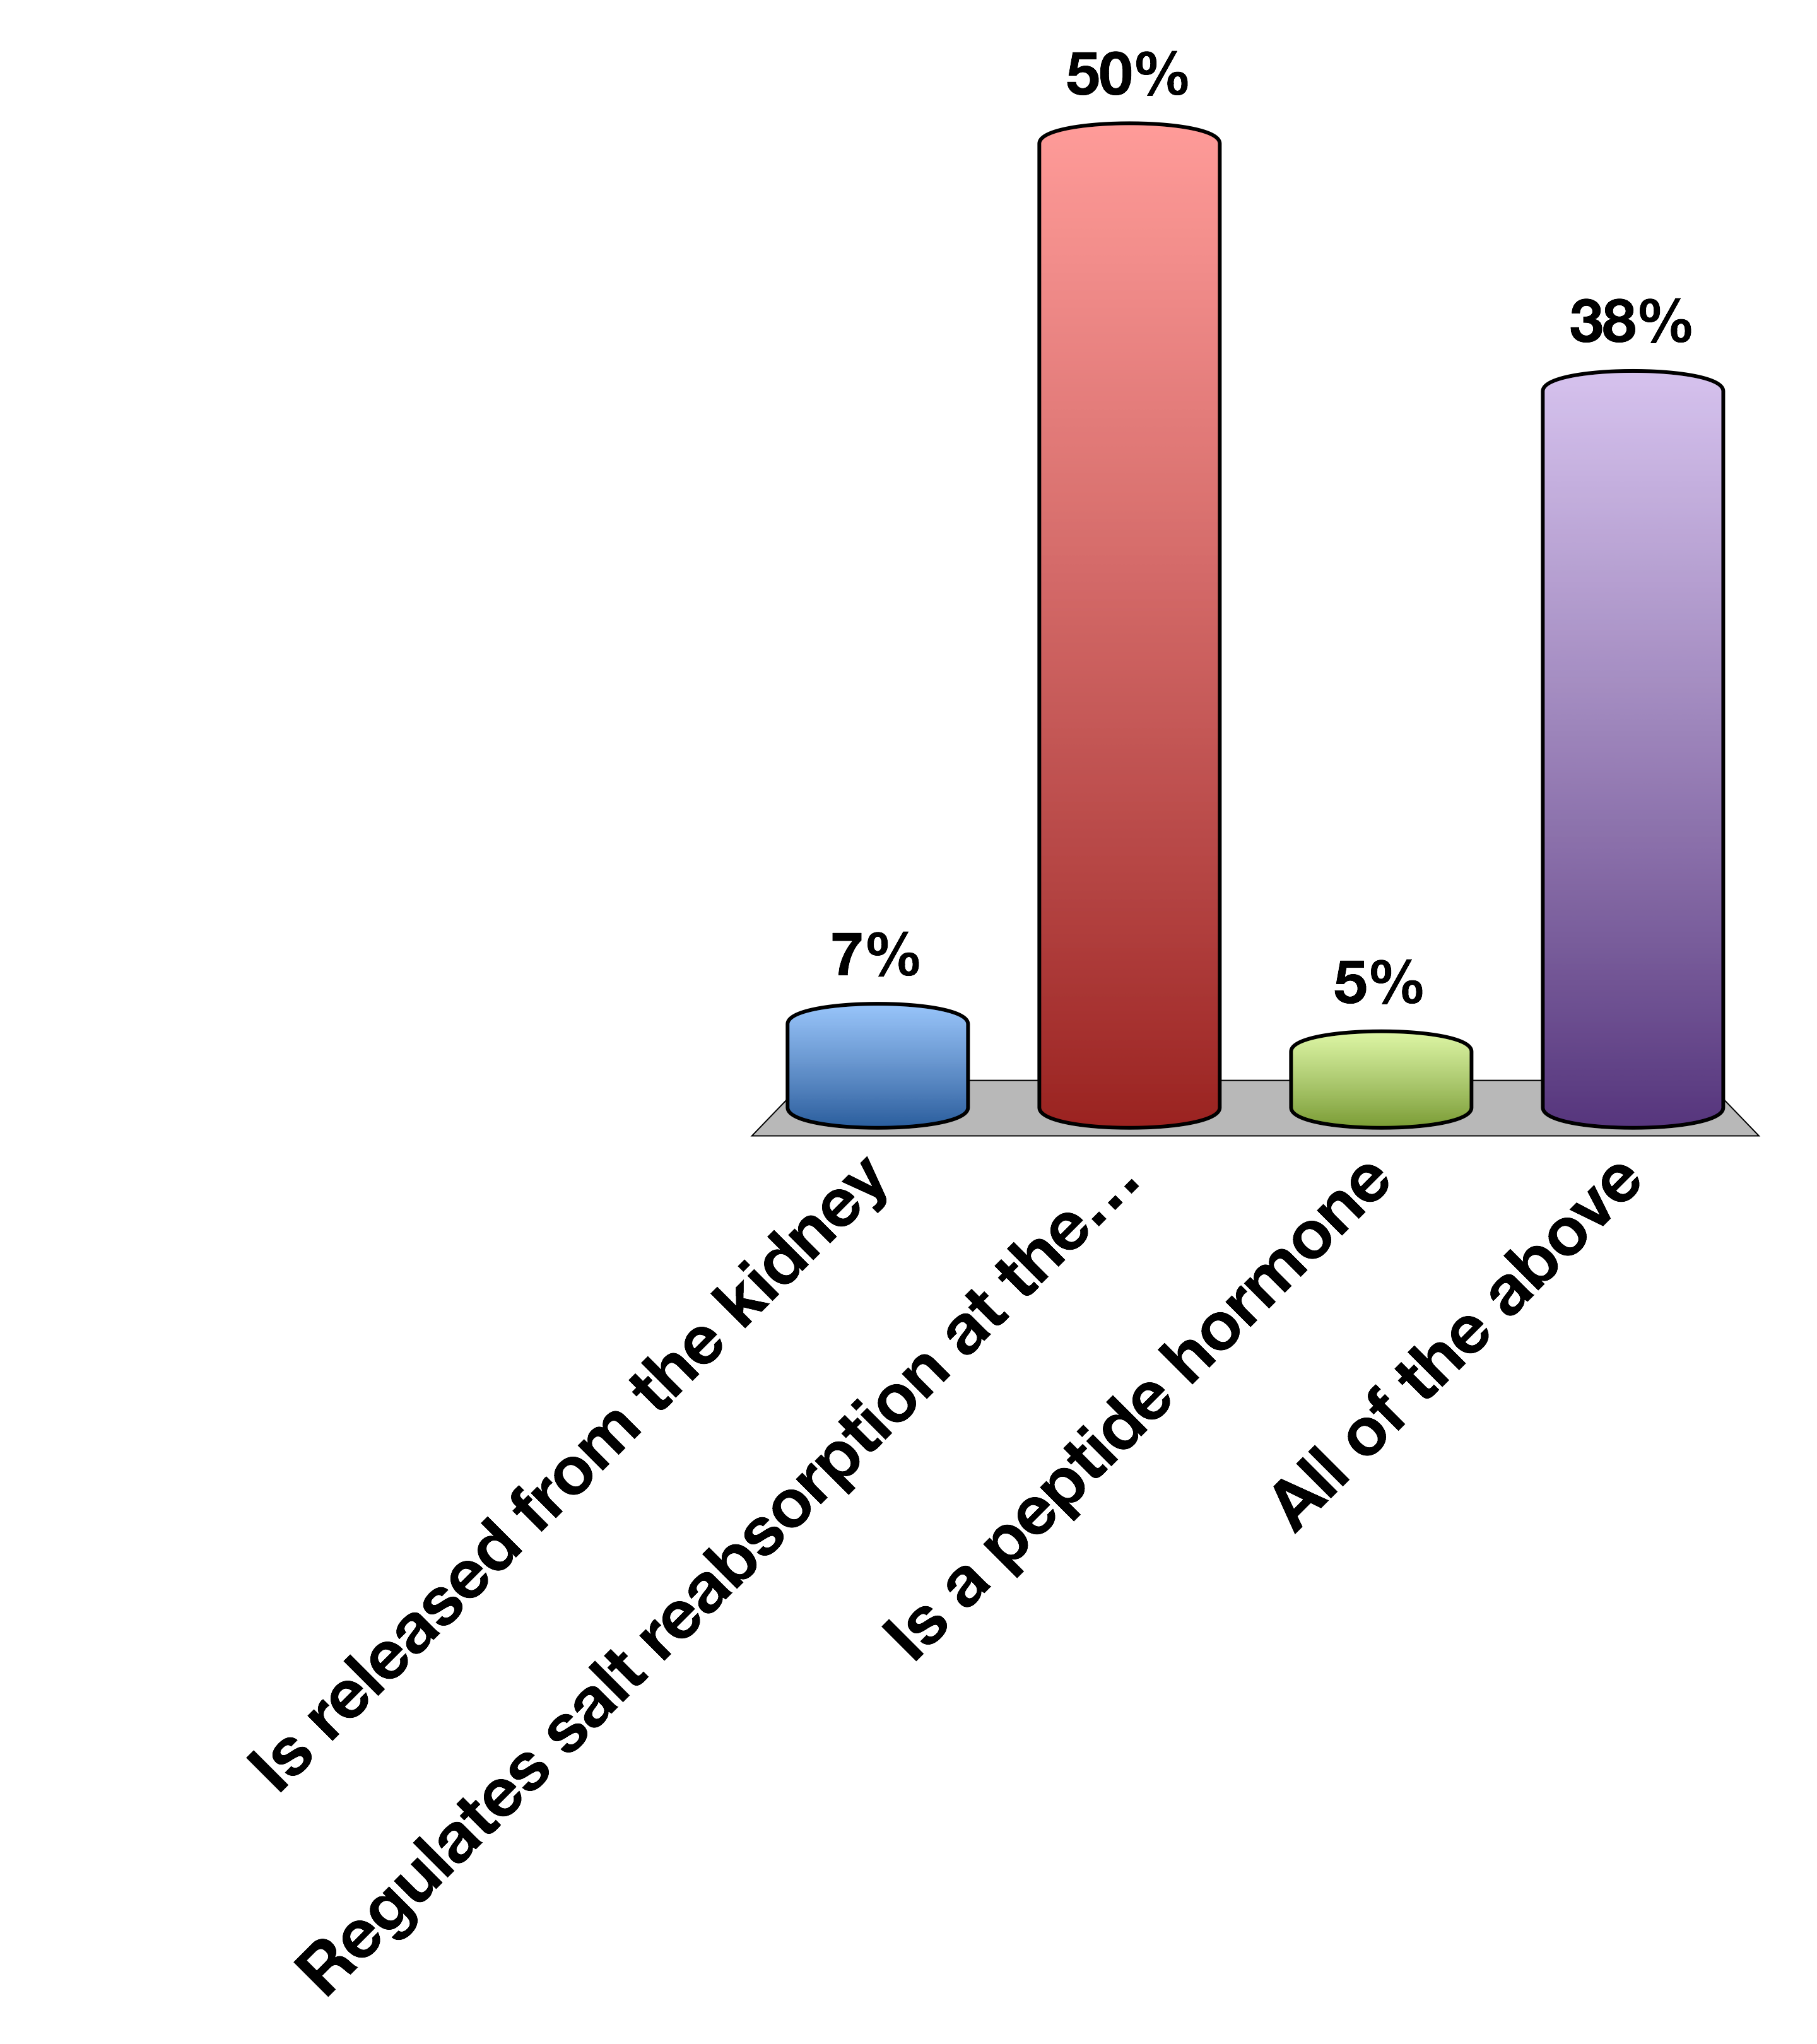
Aldosterone…
Is released from the kidney
Regulates salt reabsorption at the kidney
Is a peptide hormone
All of the above
0

Slide 9
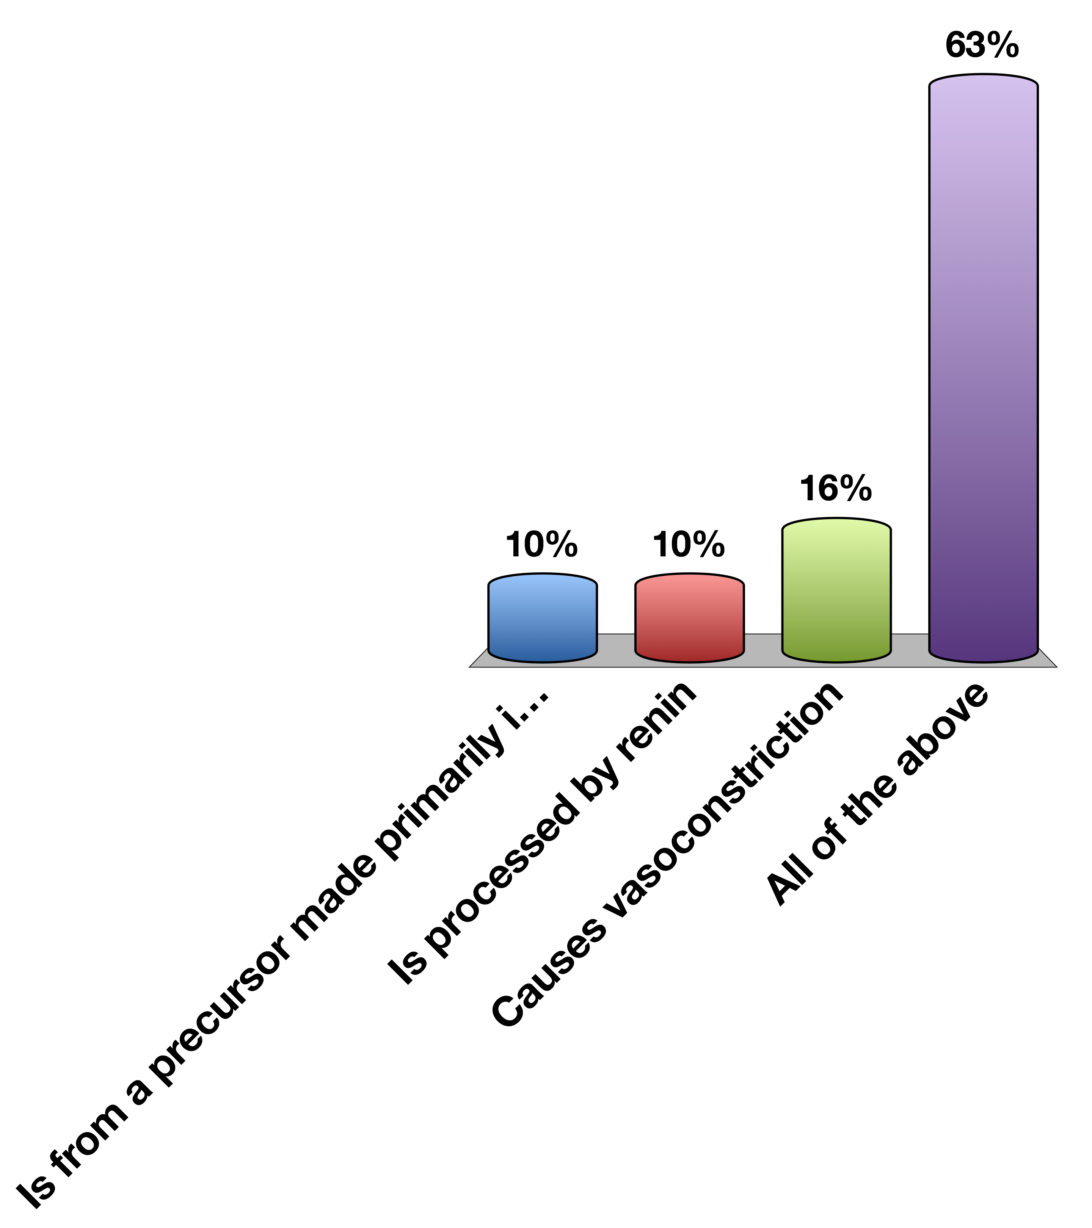
Angiotensin…
Is from a precursor made primarily in the liver
Is processed by renin
Causes vasoconstriction
All of the above
0

Slide 10
Basic Concepts in ENdocrinology

Slide 11
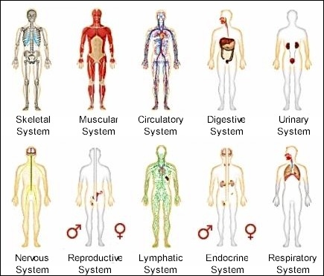
Organ Systems
Notes:
Most organ systems you are learning about in this series are physically connected organelles. These organelles evolved to have extremely important specialized functions, but in physiology these systems must be able to communicate with each other and the outside world
Two important aspects
communicate metabolic status between tissues
Integrate with nervous system to respond to external cues

Slide 12
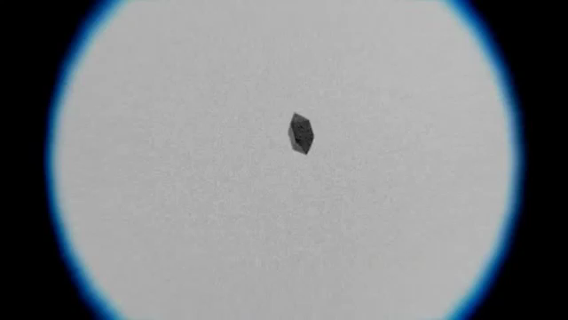
Extracellular Sensing
https://www.youtube.com/watch?v=F6QMU3KD7zw
Notes:
Bacteria chemotaxis around a sugar cube

Slide 13
What are the important processes?
There has to be a signal
That signal has to be detected
The cell has to respond to that signal
After a while the signal has to be stopped
Notes:
These are the same considerations for understanding endocrine factors

Slide 14
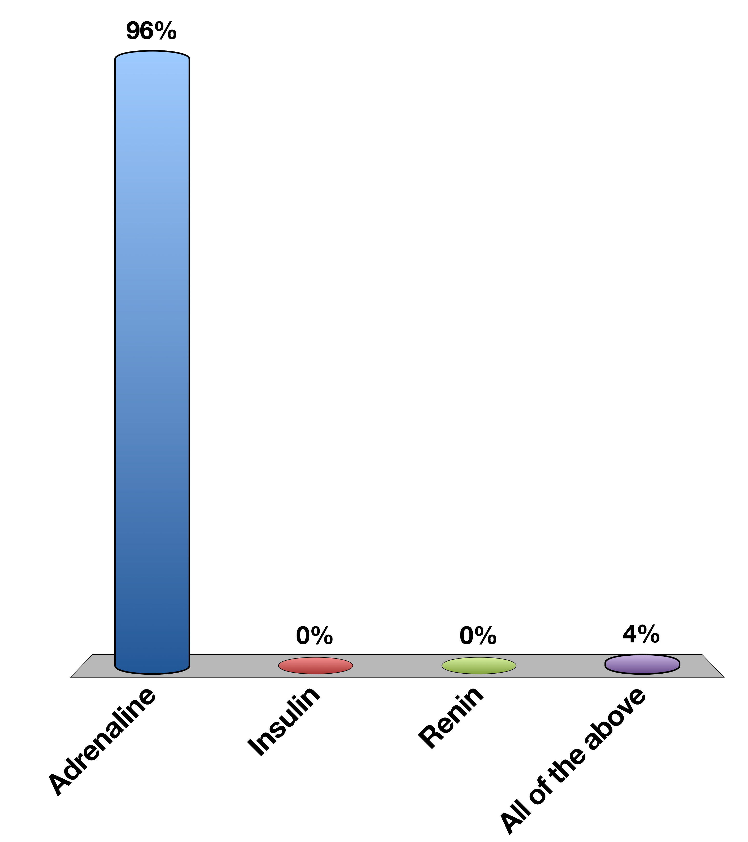
When the fight or flight response increases blood flow to muscles, what is the signal
Adrenaline
Insulin
Renin
All of the above
0

Slide 15
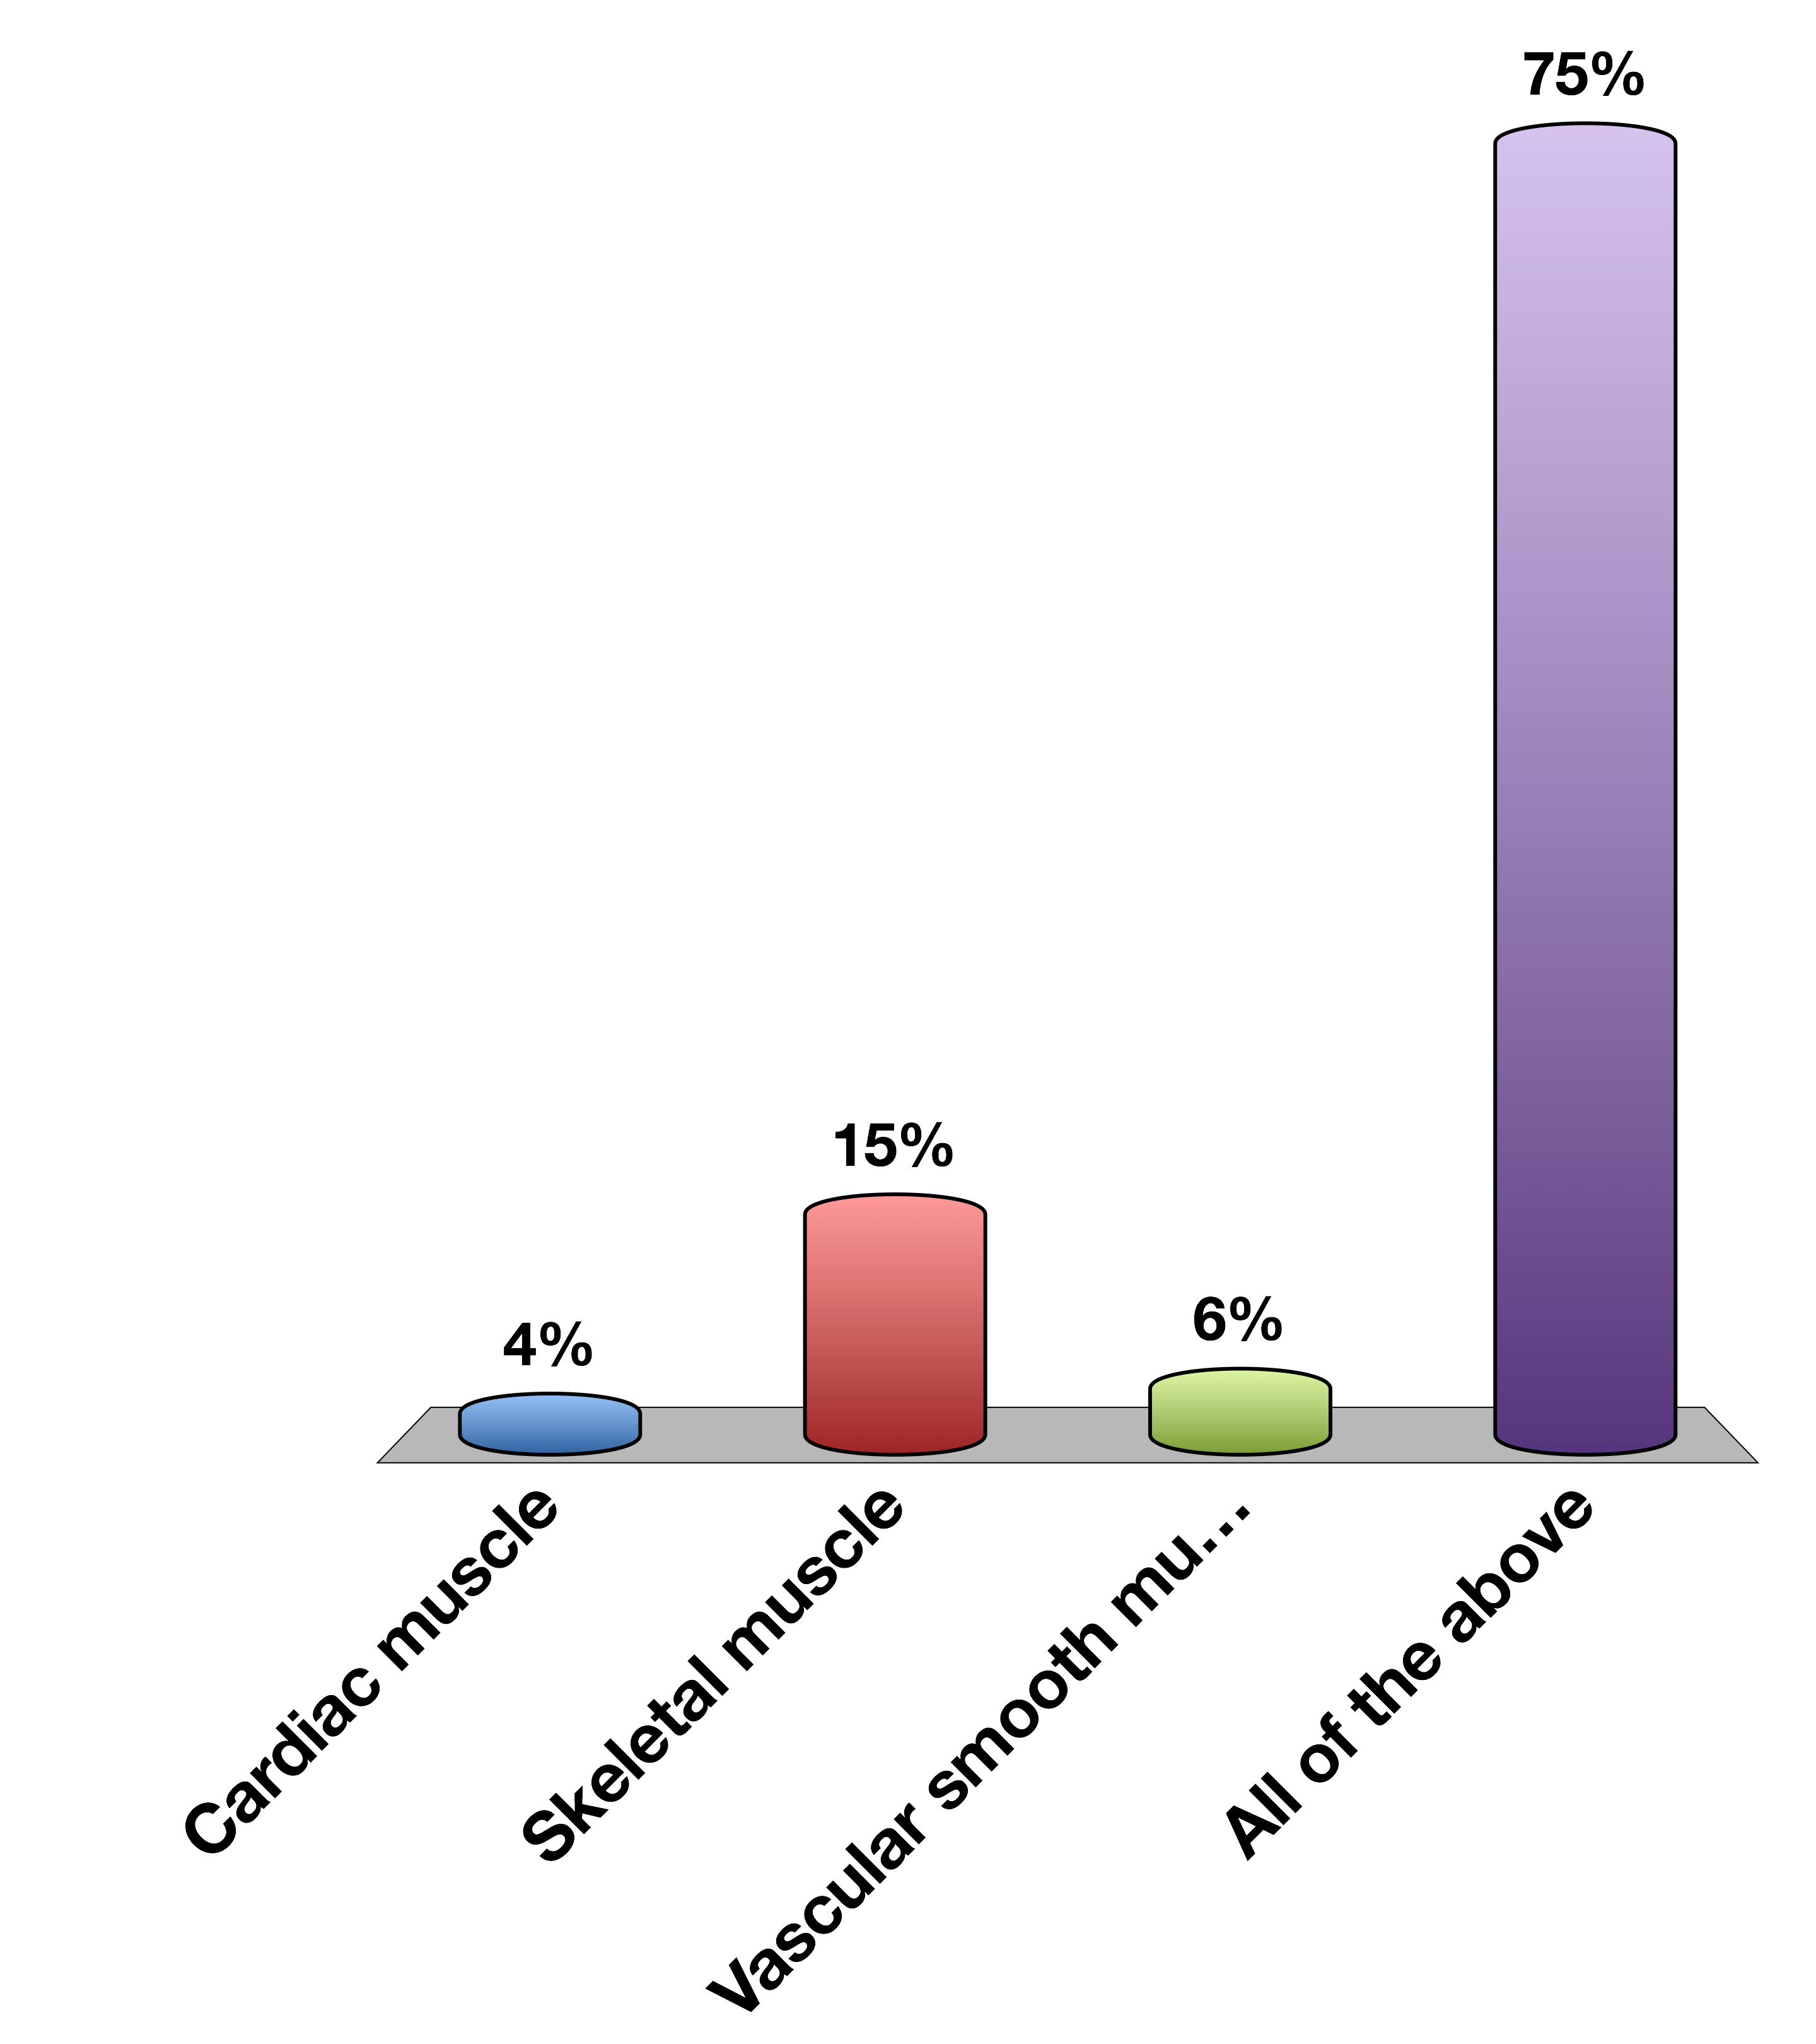
What cells respond to that signal
Cardiac muscle
Skeletal muscle
Vascular smooth muscle
All of the above
0

Slide 16
What do we need to know about a hormone?
What kind of chemical is it?
Where is it made?
What causes its release?
What are its receptors?
What tissues does it effect?
How does it get turned off
Notes:
We are going to cover some general concepts about each of these

Slide 17
Example Adrenaline
What kind of chemical is it? | Biogenic Amine | Tyrosine Derivative
Where is it made? | Adrenal medulla
What causes its release? | Sympathetic nervous stimulation
What is its receptor? | Alpha/Beta-Adrenergic Receptors | GPCR -> Gs and Gi
What tissues does it affect? | Heart | Increased heart rate
 | Lungs | Increased respiration
 | Vasculature | Vasoconstriction (smooth muscle), vasodilation (skeletal muscle)
 | Liver | Glycogenolysis
 | Fat | Lipolysis
 | Skeletal Muscle | Contraction
How does it get turned off? | Sympathetic signal stops/ Receptor desensitization
Notes:
Easy cheat sheet for each hormone, don’t need to know this for adrenaline yet.
Will cover this again on Thursday’s lecture

Slide 18
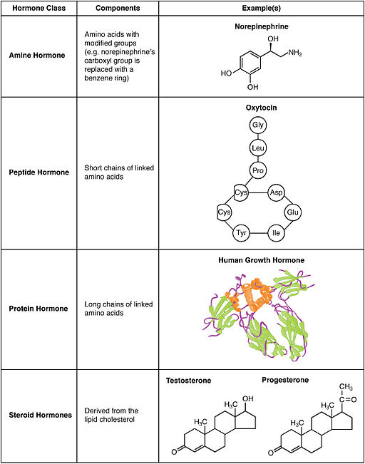
What Kinds of Hormones Are There?
Notes:
Note size of human growth hormone
Which one is most likely able to cross a plasma membrane?
What does this tell us about where the receptors are?

Slide 19
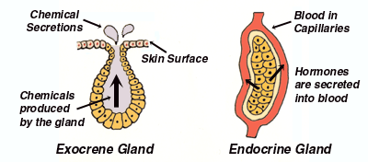
Endocrine vs Exocrine
Notes:
What are some examples of exocrine secretions?
Sweat
Saliva
Gall bladder – bile salts
Pancreas – digestive enzymes (controlled by endocrine activation via gastrin/secretin/cholecystikinin)

Slide 20
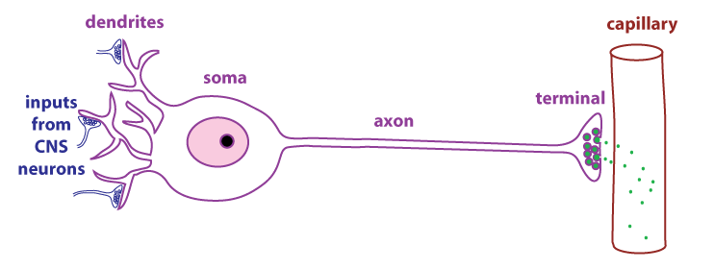
Neuroendocrine Secretions

Slide 21
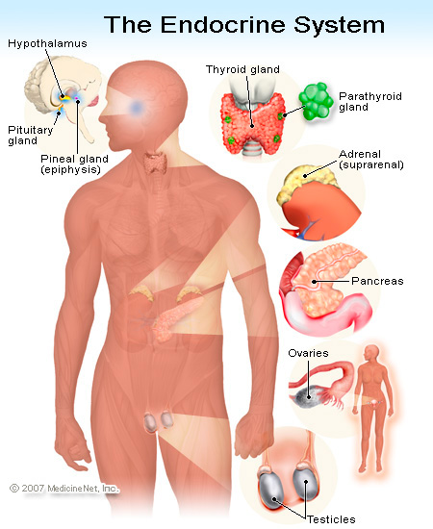
Generally, where are hormones made
Notes:
Total oversimplification as hormones are now known to be made in many other tissues (gut/fat/muscle).
Point out that the same gland often makes hormones of the same chemical class, even though they exert different effects

Slide 22
Generally how are hormones released?
Nervous stimulation
Adrenaline, CRH, TSH
In Response to Another Hormone
Cortisol (ACTH), Thyroid Hormones (TSH)
In Response to A Metabolite
Insulin, Glucagon, Calcitonin
In Response to Physical Changes Such As Stretch
Ghrelin, Renin
Notes:
If its release due to synaptic activation, what kind of secretion is it?
Calcitonin responds to elevated calcium

Slide 23
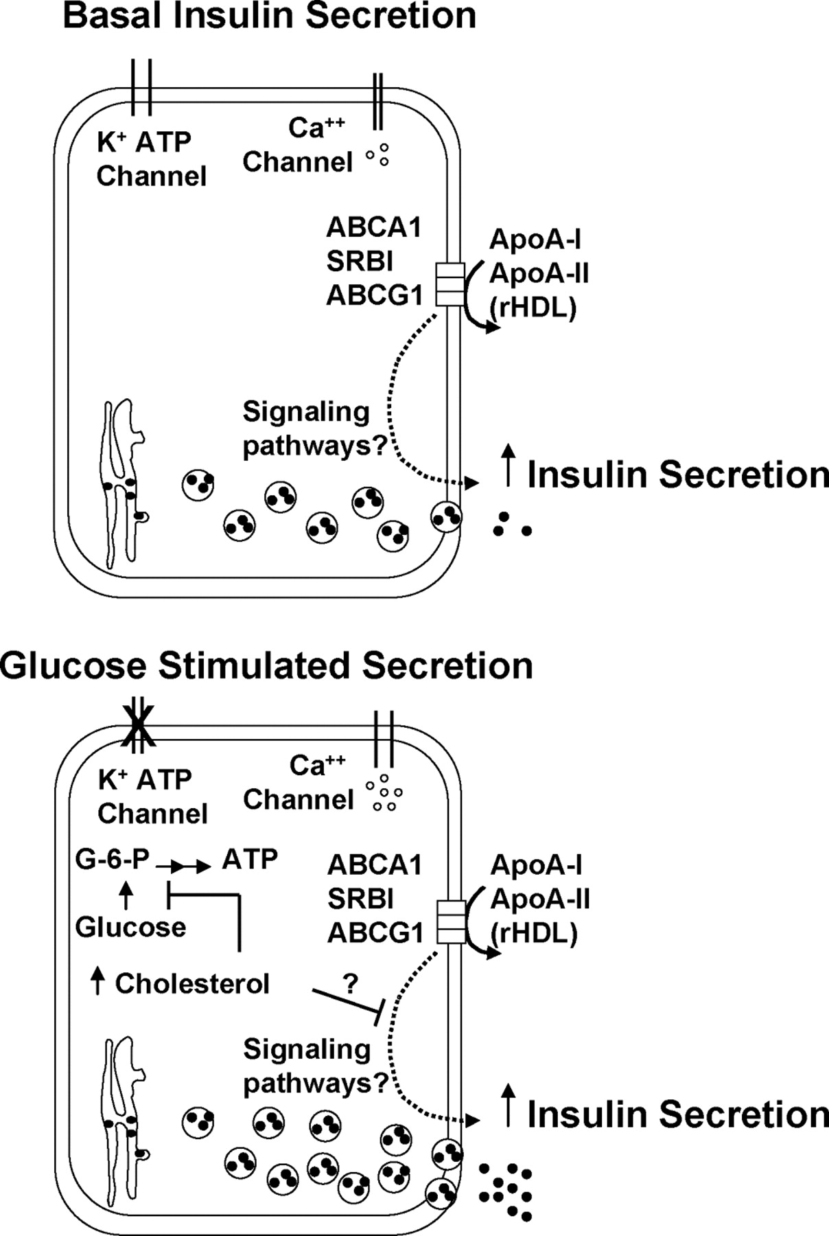
Basal vs Stimulated Secretion

Slide 24
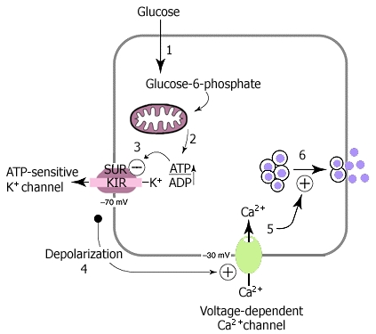
Insulin Release In Response To Glucose
Notes:
Muscarinic, or parasympathetic activation can also depolarize these neurons, causing Ca influx and insulin release

Slide 25
How Do Hormones Affect Cells?
Activate or inactivate specific proteins
Traffic things around in the cell
Generate new mRNA/proteins
Notes:
Talk about insulin secretion example
Activated a potassium channel
Caused trafficking of insulin granules
Not shown, this activation also causes synthesis of new insulin hormone to replace the secreted insulin

Slide 26
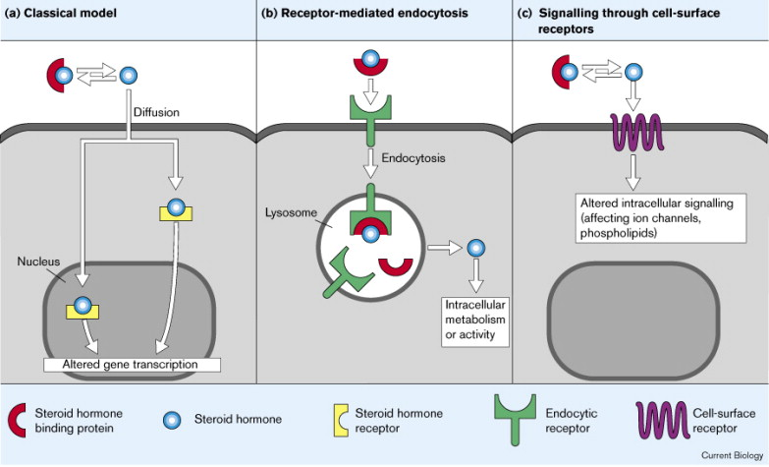
What Kinds of Receptors Are There?
Notes:
If I tell you the chemical type of the hormone, you should be able to tell me whether it is a nuclear hormone or a cell surface receptor

Slide 27
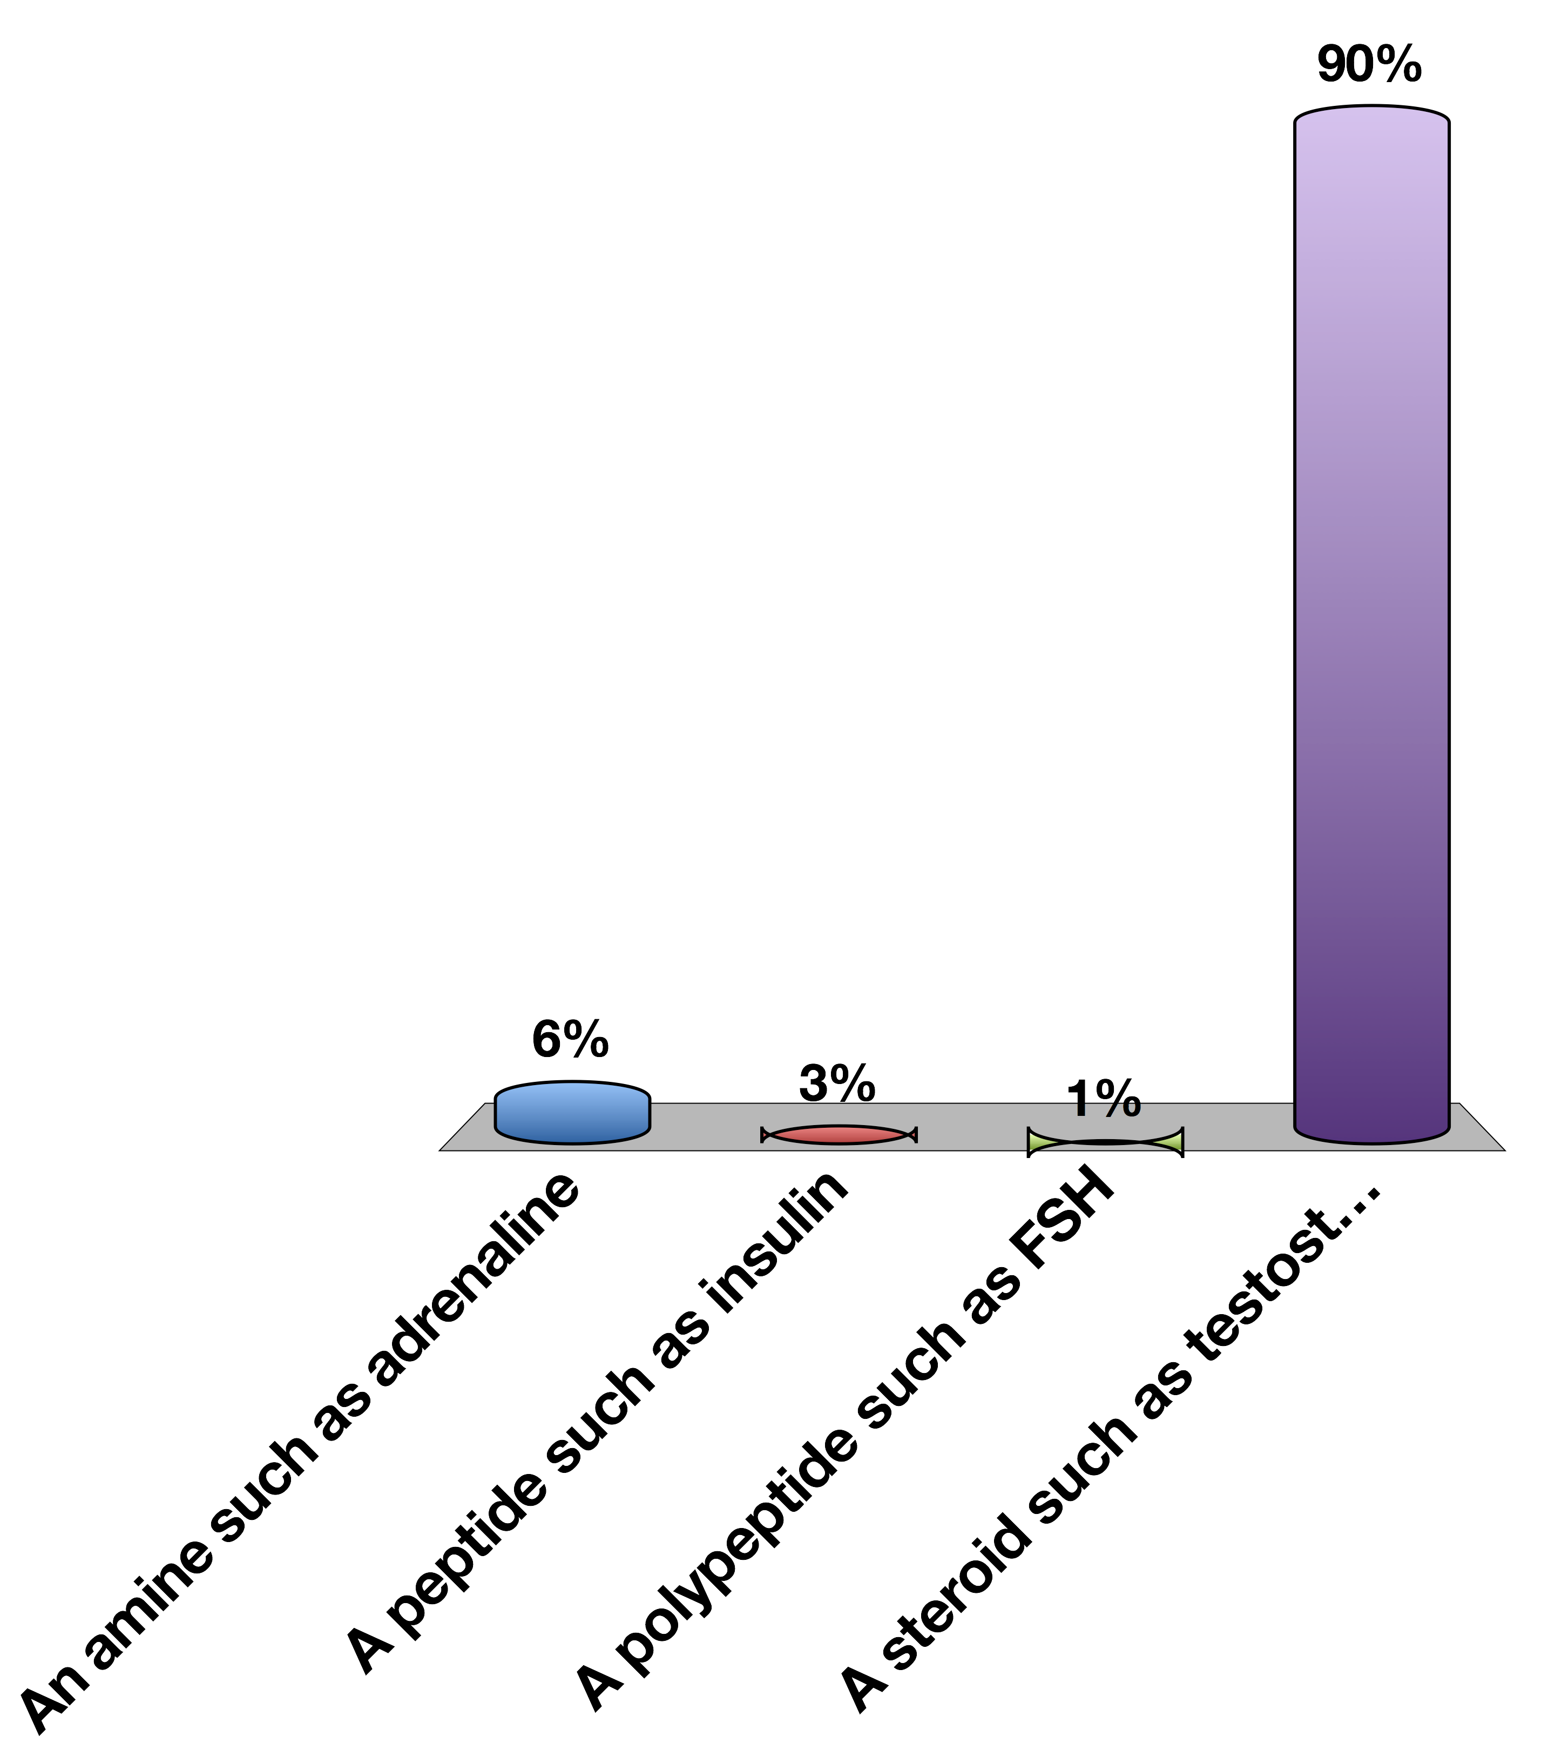
Which hormone type is most likely to be able to cross plasma membranes
An amine such as adrenaline
A peptide such as insulin
A polypeptide such as FSH
A steroid such as testosterone
0

Slide 28
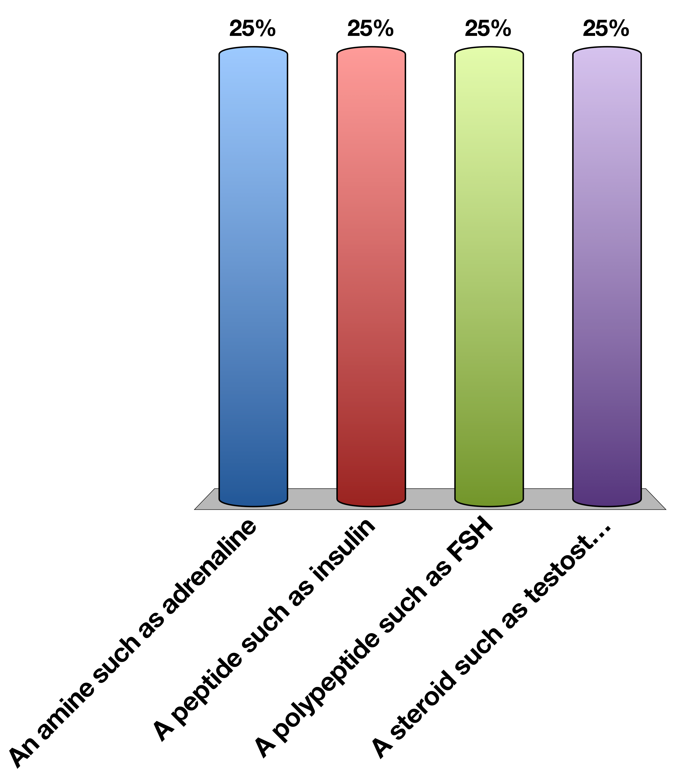
Which hormone type is most likely to be able to cross plasma membranes
An amine such as adrenaline
A peptide such as insulin
A polypeptide such as FSH
A steroid such as testosterone
15

Slide 29
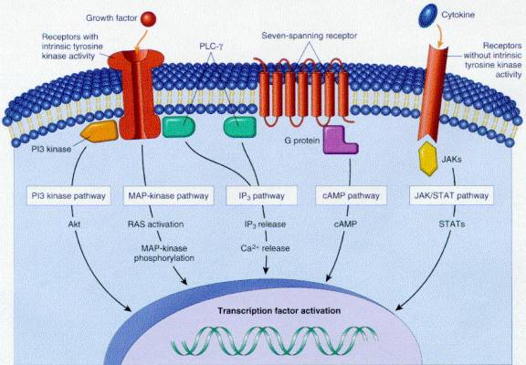
Cell Surface Receptors

Slide 30
Types of Cell Surface Receptors
GPCRs
Receptor Tyrosine Kinases
JAK/STAT Receptors
7-TM
Activates G proteins in several classes
Can regulate cAMP, Ca, DAG and RhoGTPases
Example β−AR
1-TM (dimer)
Autophosphorylate on tyrosine residues
Recruits and activates effectors like Akt
Example InsR
1-TM (dimer)
Recruits kinase (JAK) which phosphorylates effectors (STAT)
pSTAT activates gene transcription
Example GH
Notes:
Finish by saying JAK/STAT mainly affects gene transcription

Slide 31
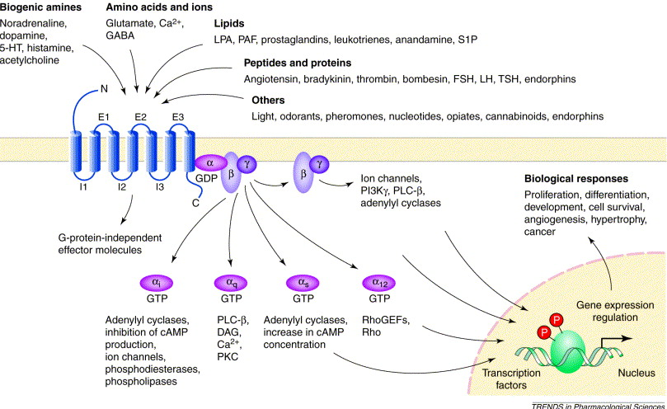
GPCRs
Notes:
Should be about 25 minutes at this point.

Slide 32
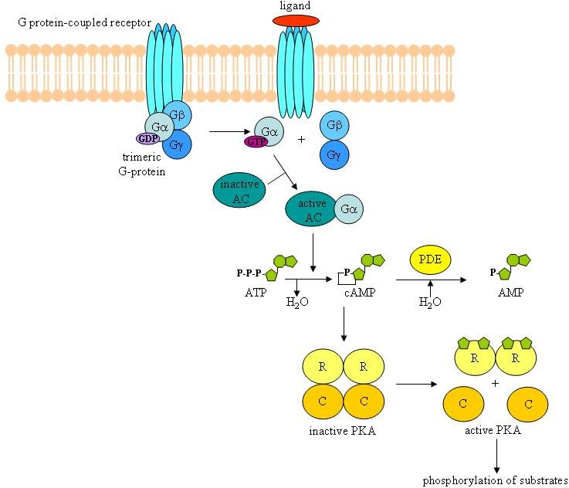
GPCRs and PKA
Notes:
Point out that this is for a Gs not a Gi

Slide 33
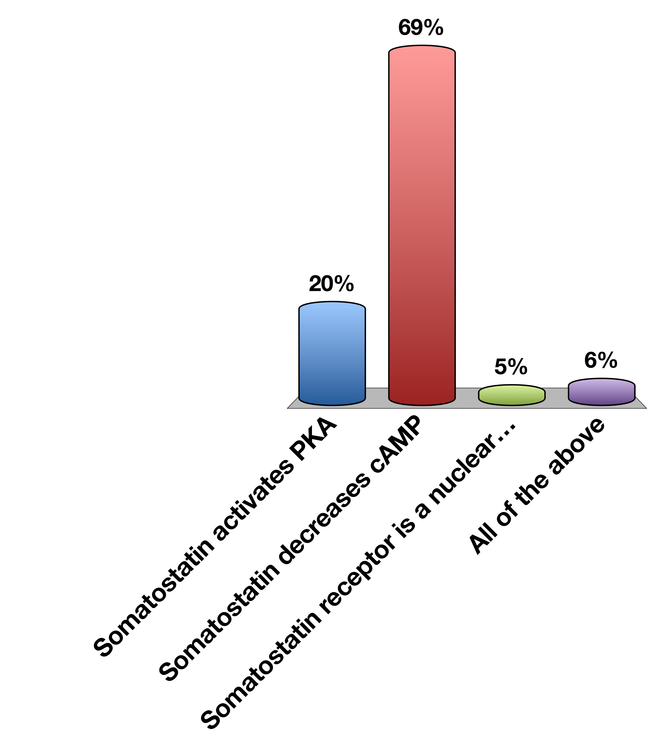
Somatostatin is a Gi-linked GPCR
Somatostatin activates PKA
Somatostatin decreases cAMP
Somatostatin receptor is a nuclear hormone receptor
All of the above
0

Slide 34
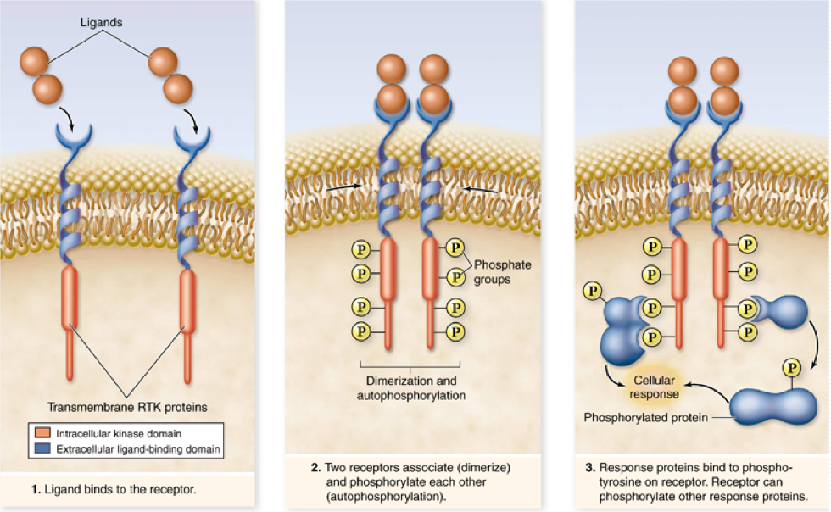
Receptor Tyrosine Kinases
Notes:
Mention both GPCR and RTK can cause rapid changes in trafficking or enzyme function

Slide 35
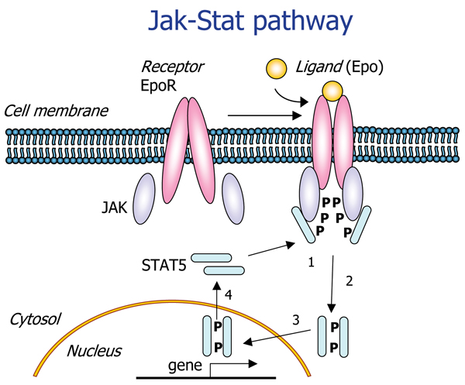
JAK/STAT Receptors

Slide 36
Nuclear Hormone Receptors

Slide 37
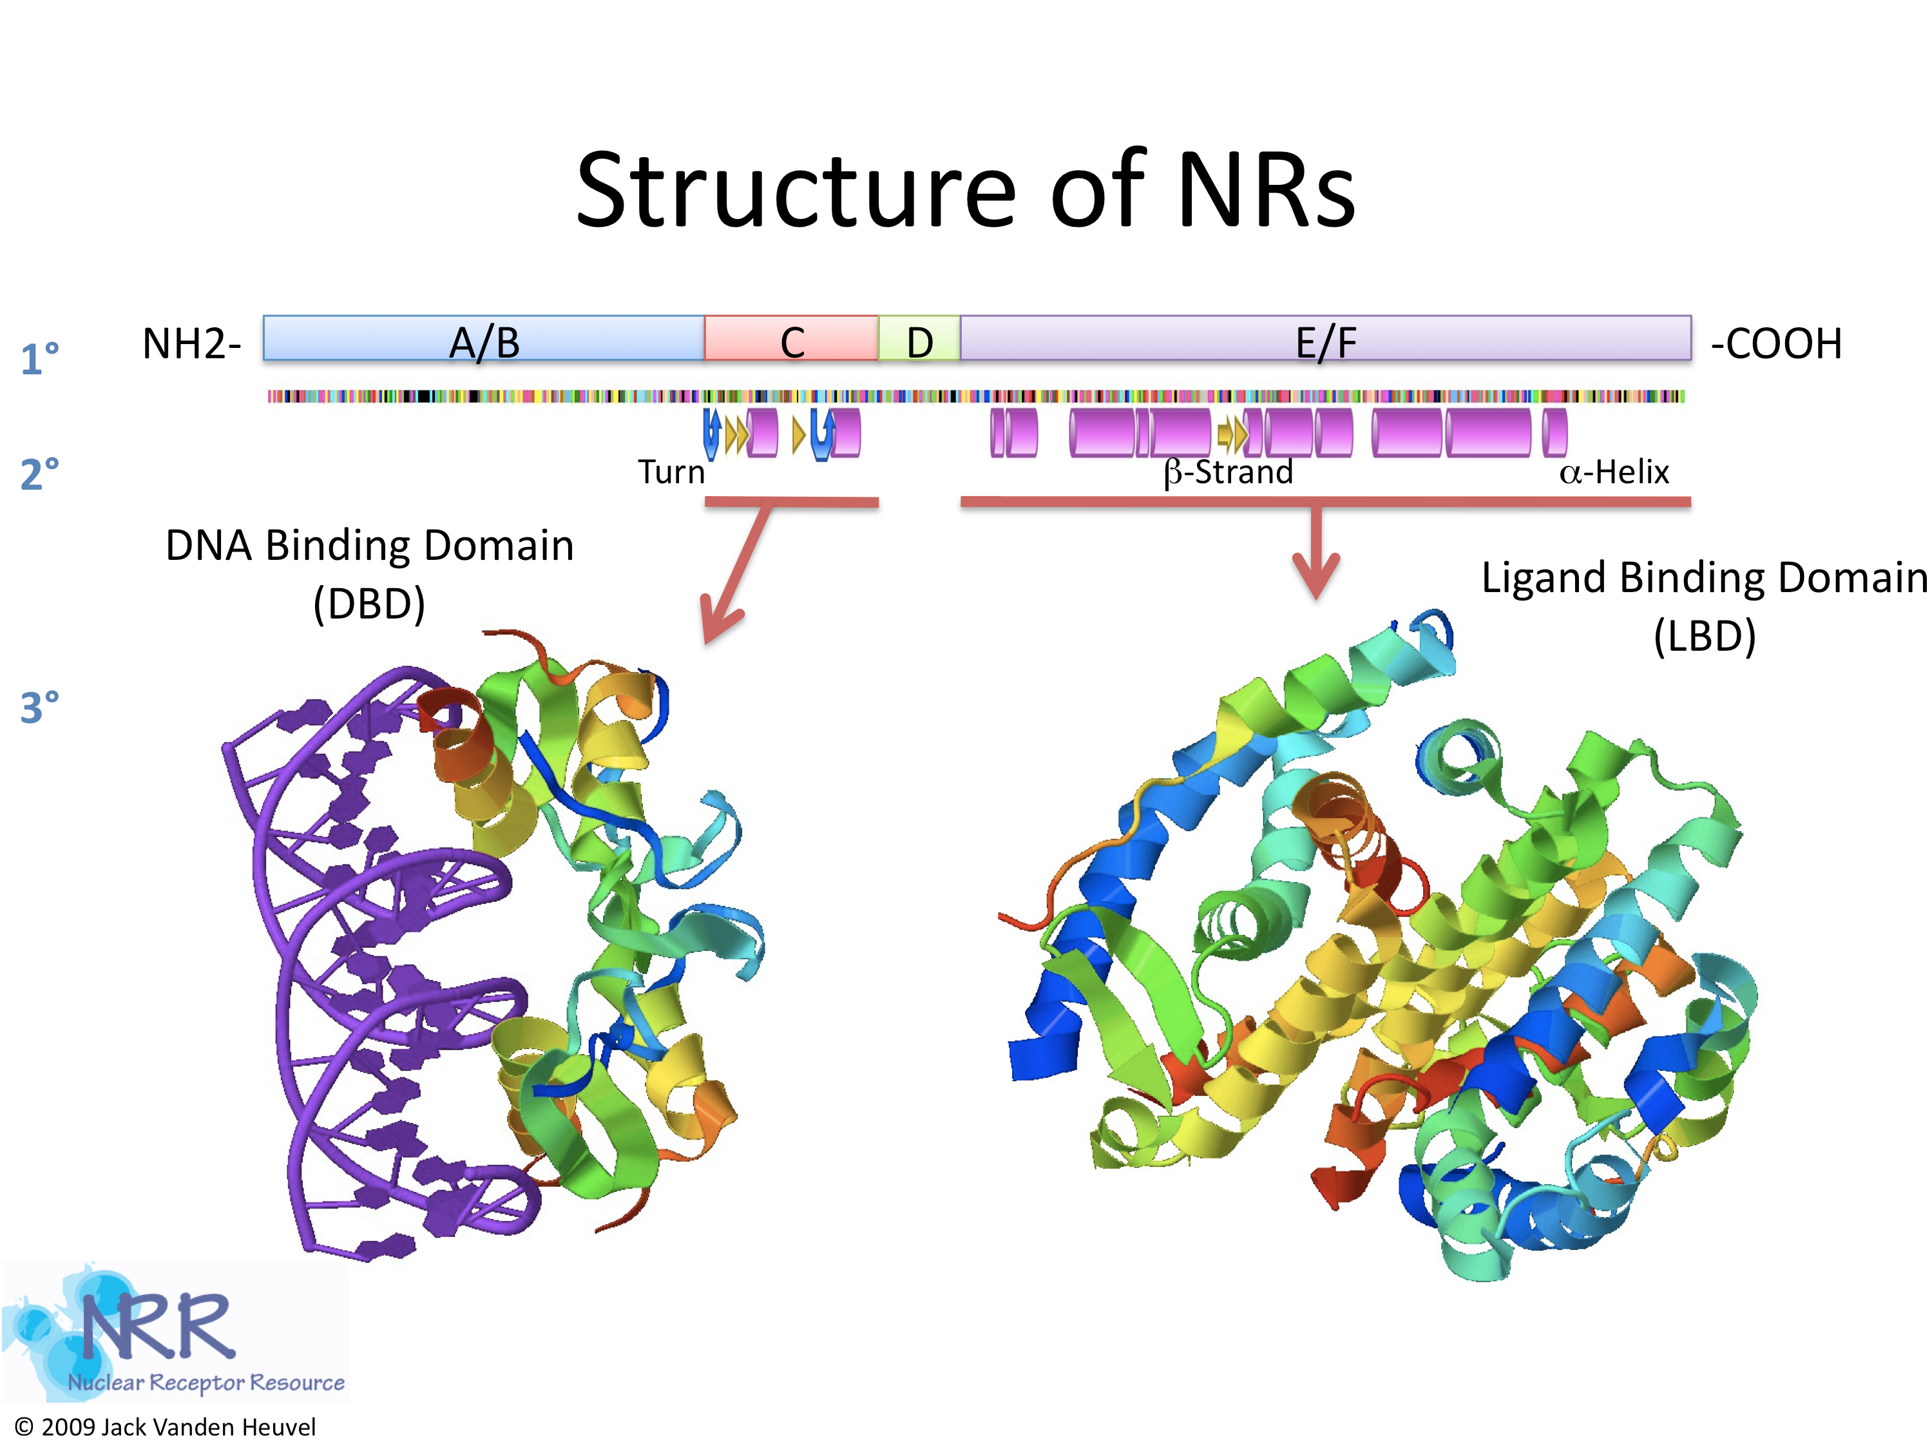
What Do Nuclear Hormones Look Like?
Notes:
DBD – defines target, recognizes specific regions of DNA. This determines which genes are activated
LBD – defines ligand specificity. If cortisol receptor was activated by testosterone, then cortisol responsive genes would be activated by testosterone

Slide 38
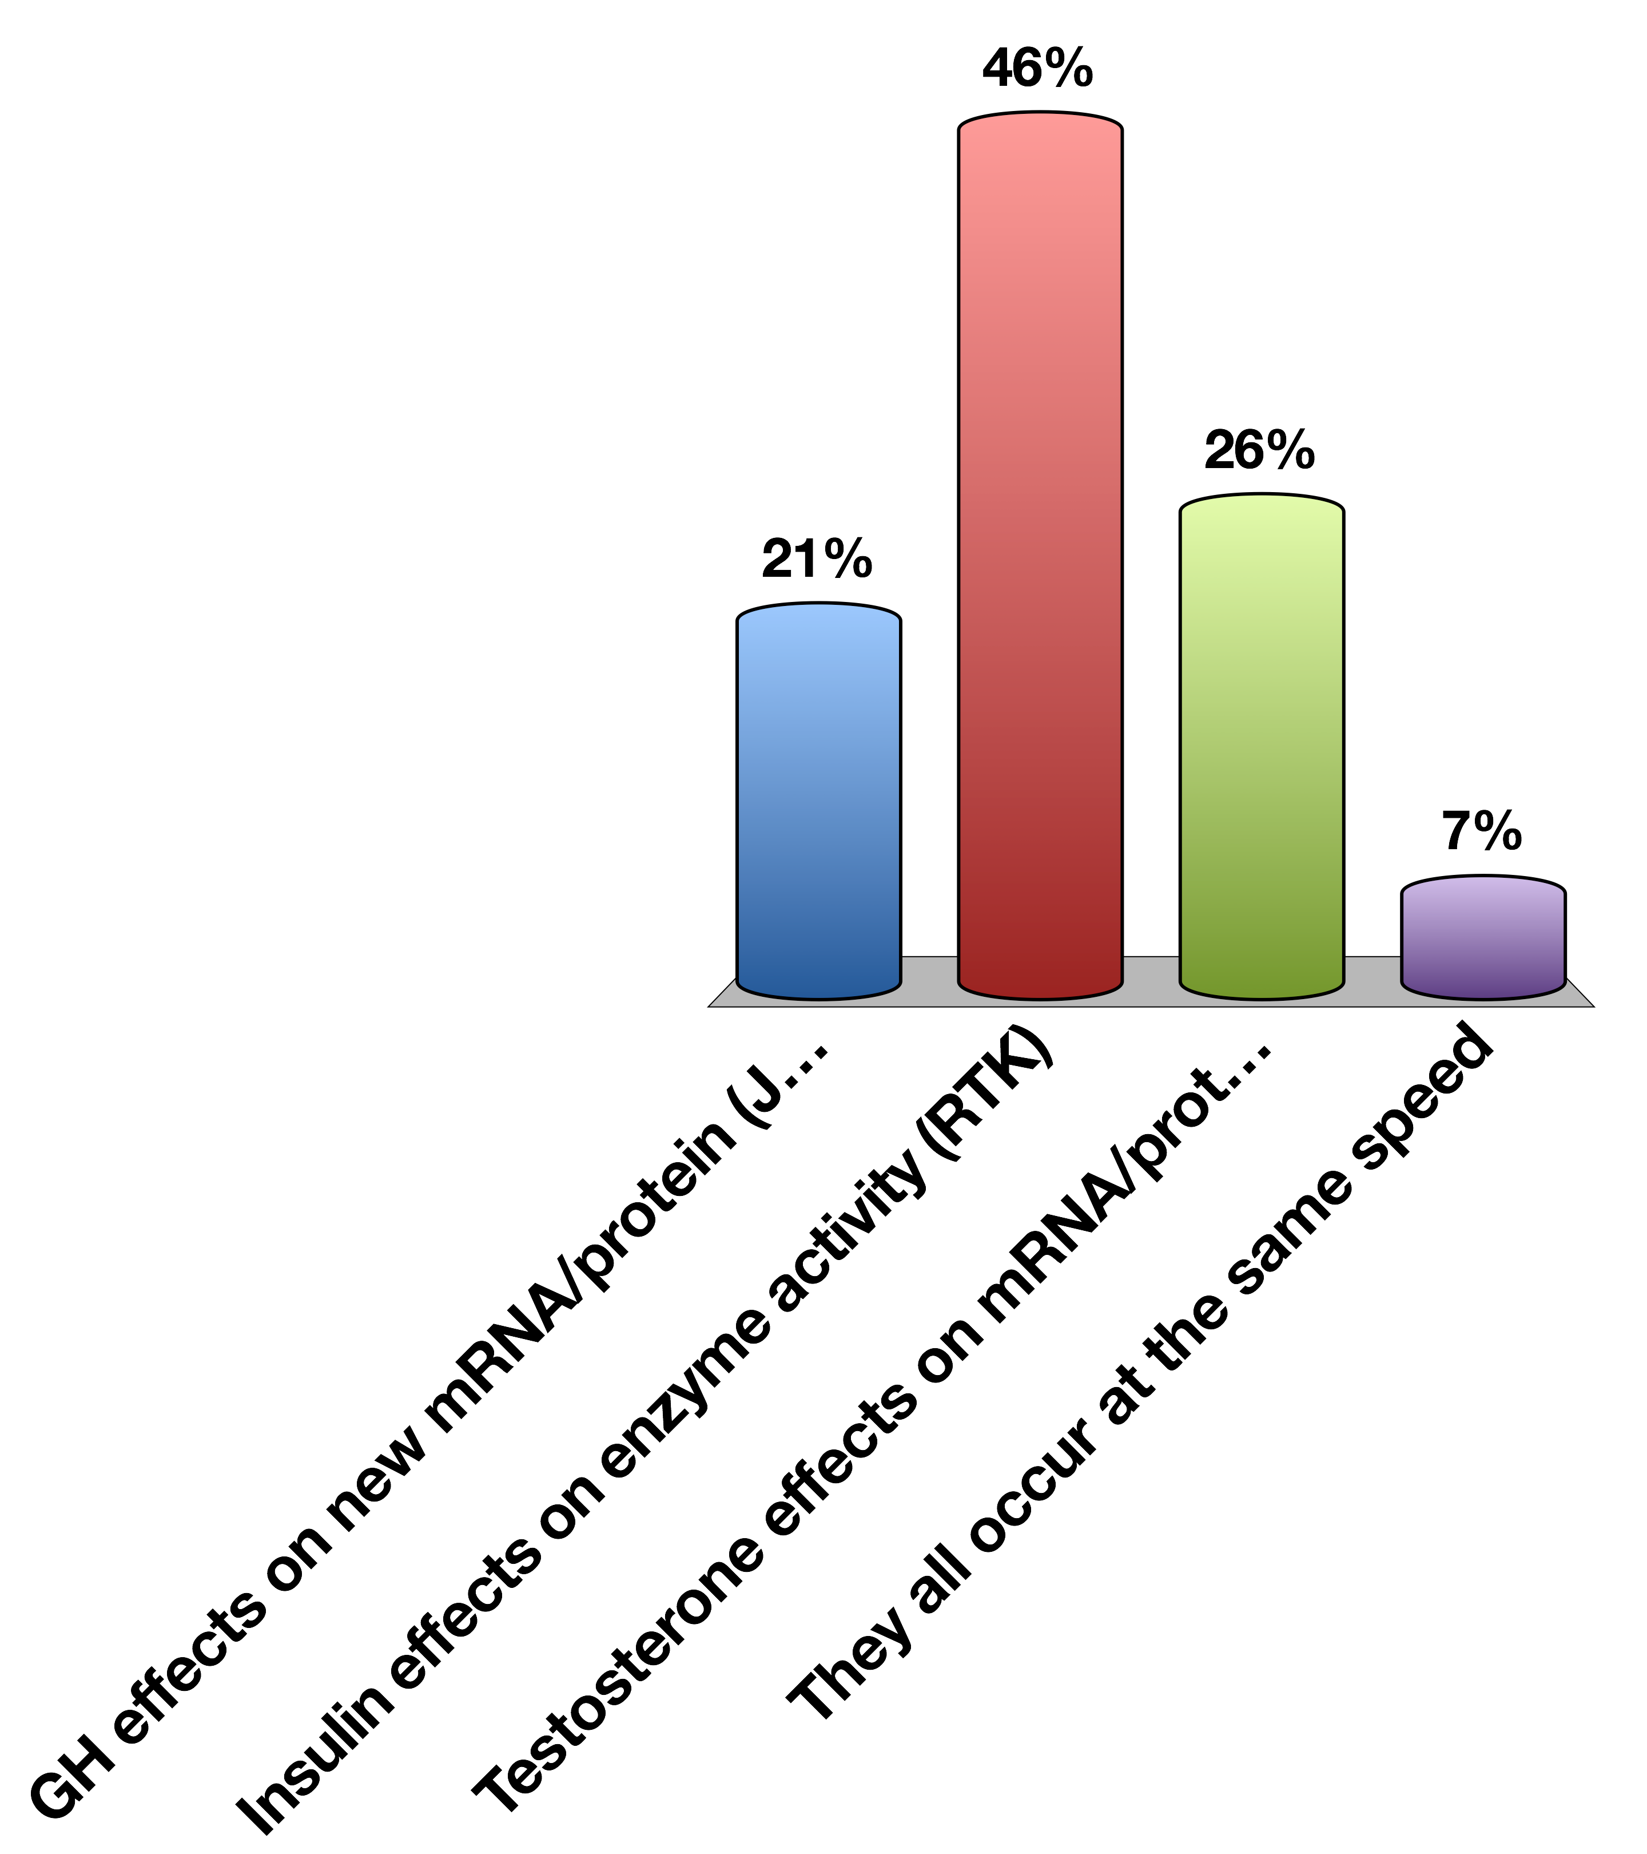
Which hormonal responses will occur fastest?
GH effects on new mRNA/protein (JAK/STAT)
Insulin effects on enzyme activity (RTK)
Testosterone effects on mRNA/protein (NHR)
They all occur at the same speed
0

Slide 39
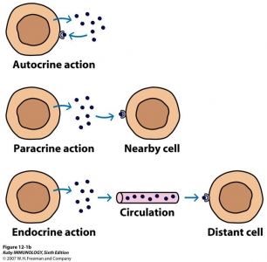
Relative Location of Action
Notes:
Autocrine example: Many cancers function by releasing a growth factor, which in turn further activates proliferation of the cell. This is a POSITIVE FEEDBACK LOOP.

Slide 40
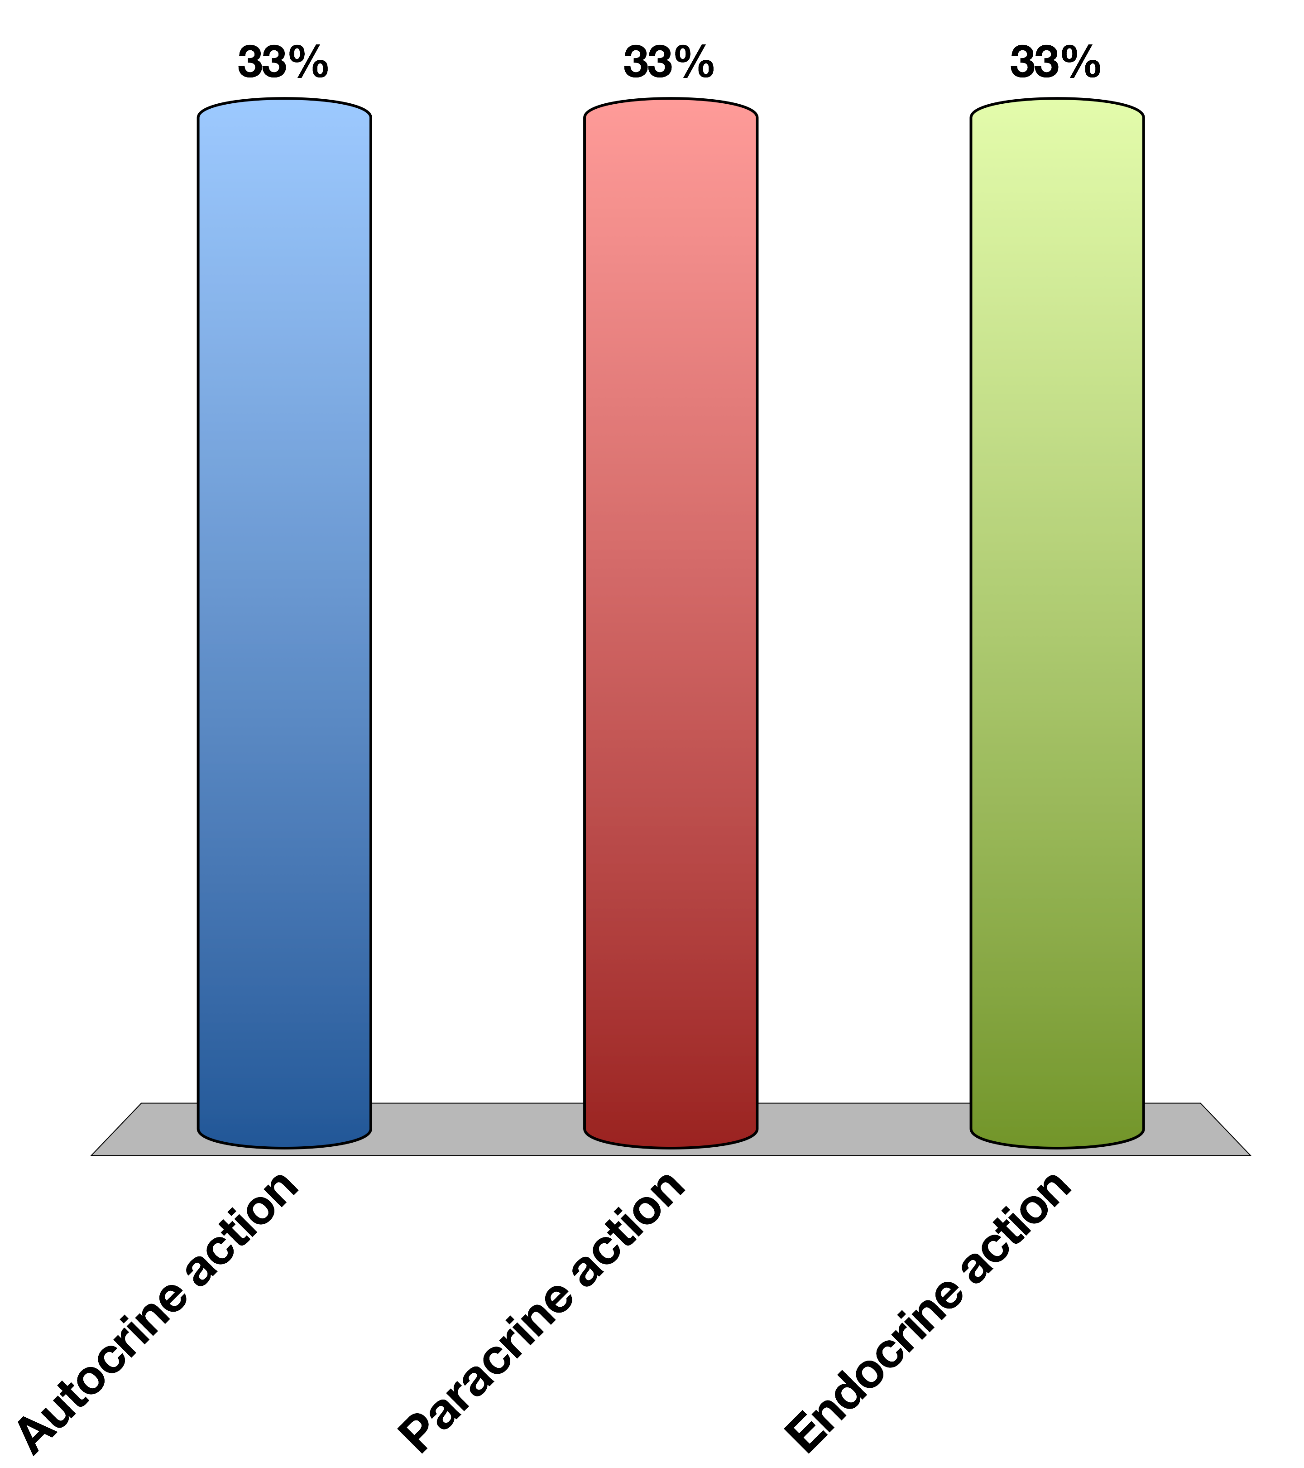
Insulin is released from pancreatic beta cells and is sensed by pancreatic alpha cells to reduce glucagon secretion. This is an example of …
Autocrine action
Paracrine action
Endocrine action
15

Slide 41
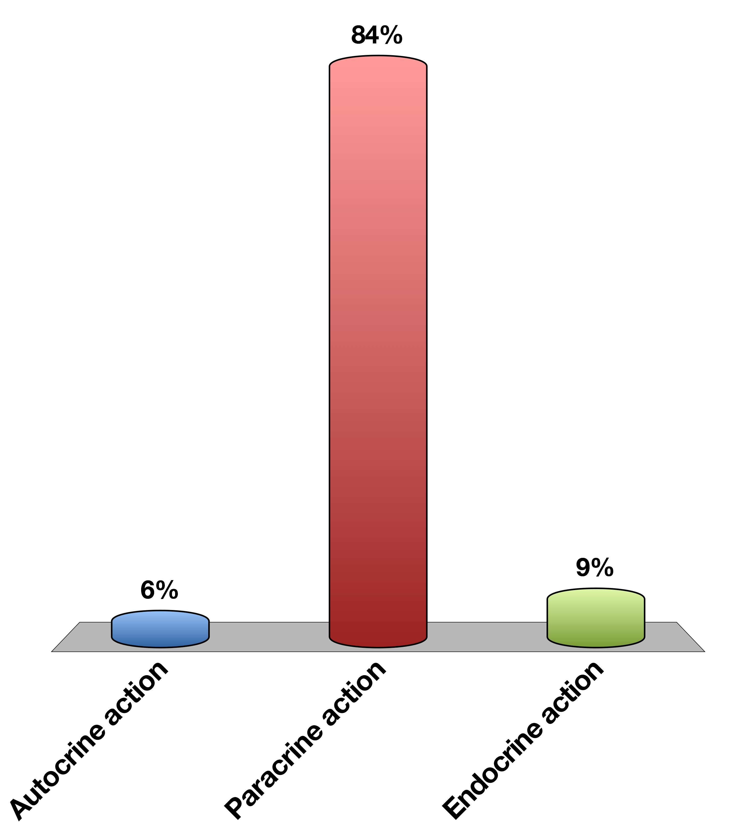
Insulin is released from pancreatic beta cells and is sensed by pancreatic alpha cells to reduce glucagon secretion. This is an example of …
Autocrine action
Paracrine action
Endocrine action
0

Slide 42
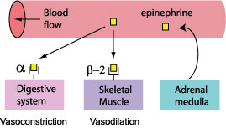
How To Get Hormonal Specificity?
Restrict the location of the hormone release (ie neurotransmitters only released into synapse)
Restrict the receptors to particular tissues
Have the receptors mediate different processes in different cell types
For more details see O’Connell’s lectures on blood pressure regulation
Notes:
Other than having specific receptors

Slide 43
Turning the Signal off
Induce hormone resistance at the target cell
Prevent further hormone production
Reduce the levels
Notes:
----- Meeting Notes (3/24/15 11:58) -----
Took 52 minutes to get to this point

Slide 44
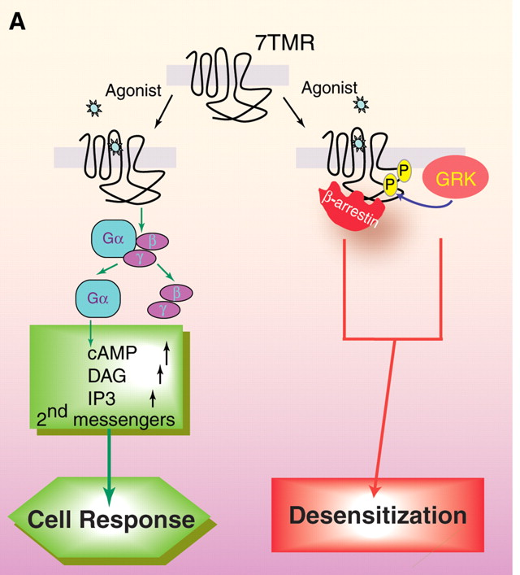
Example: Arrestins and GPCRs
Lefkowitz RJ, Shenoy SK (2005) Transduction of receptor signals by beta-arrestins. Science 308: 512–517. doi:10.1126/science.1109237.

Slide 45
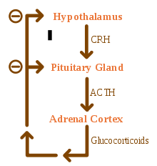
Example: Reduce New Hormone Secretion
Notes:
Point out that this is an example of neuroendocrine regulation

Slide 46
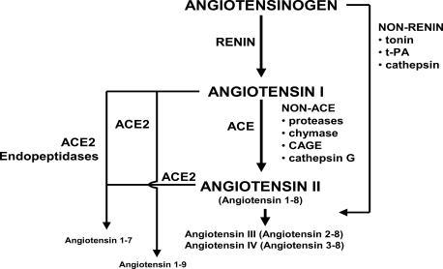
Example: Degrade Existing Hormones

Slide 47
Group Project
Pick some hormone that you think you know of its function
Imagine a patient that has no negative feedback to that hormone. What happens and why?
Now imagine another patient that has way too much negative feedback to that hormone. What happens and why?

Slide 48
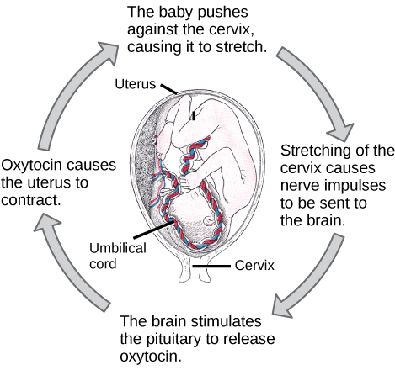
Positive Feedback Regulation
Notes:
Point out problems, ie that this loop needs an external stimulus to end

Slide 49
Integration of the CNS with Endocrine Signals
In Response To CNS
To Modify CNS
Externally sensed cues (ie, look a bear!)
Release of adrenaline
Modify peripheral responses
Internally sensed cues (ie, my stomach is full)
Feeding hormones (Leptin, Ghrelin, PYY)
Modify behavior

Slide 50
Learning Objectives
Define endocrine, paracrine, autocrine, and exocrine systems, define neuro-secretory cells by giving a few examples.
List major chemical categories of hormones and give several examples that belong to each class.
List important factors that determine hormone levels in circulation.
Explain cellular actions of hormones via membrane and nuclear receptors, including an understanding of the rates by which these processes can affect cells.
Define basal secretion and stimulated secretion of endocrine glands.
Describe negative and positive feedback system using an example.
Explain with examples neuroendocrine integration.

Slide 51
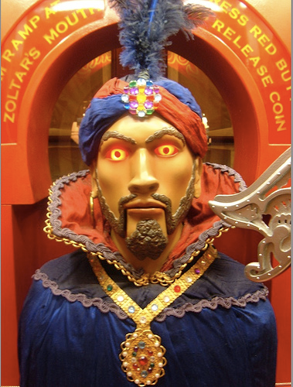
Your Future
Endocrine Control Systems
Neuroendocrinology and the Posterior Pituitary
Endocrine Control of Growth
Adrenals and Stress Hormones
Hypothalamus and Endocrine Control of Appetite
Pancreatic Hormones and Metabolic Control
Thyroid Hormones (KP)
Calcium Homeostasis (MF)
Reproductive Hormones (HP)
Notes:
ZOLTAR

Slide 52
Design a hormone
What process does it govern?
What signals its release? Does it result from external cues, or internal cues?
Under what time-scale does this change occur?
What should end the signaling event?
What would be the pathophysiology of this hormone not existing? How about being far too active?

Slide 53
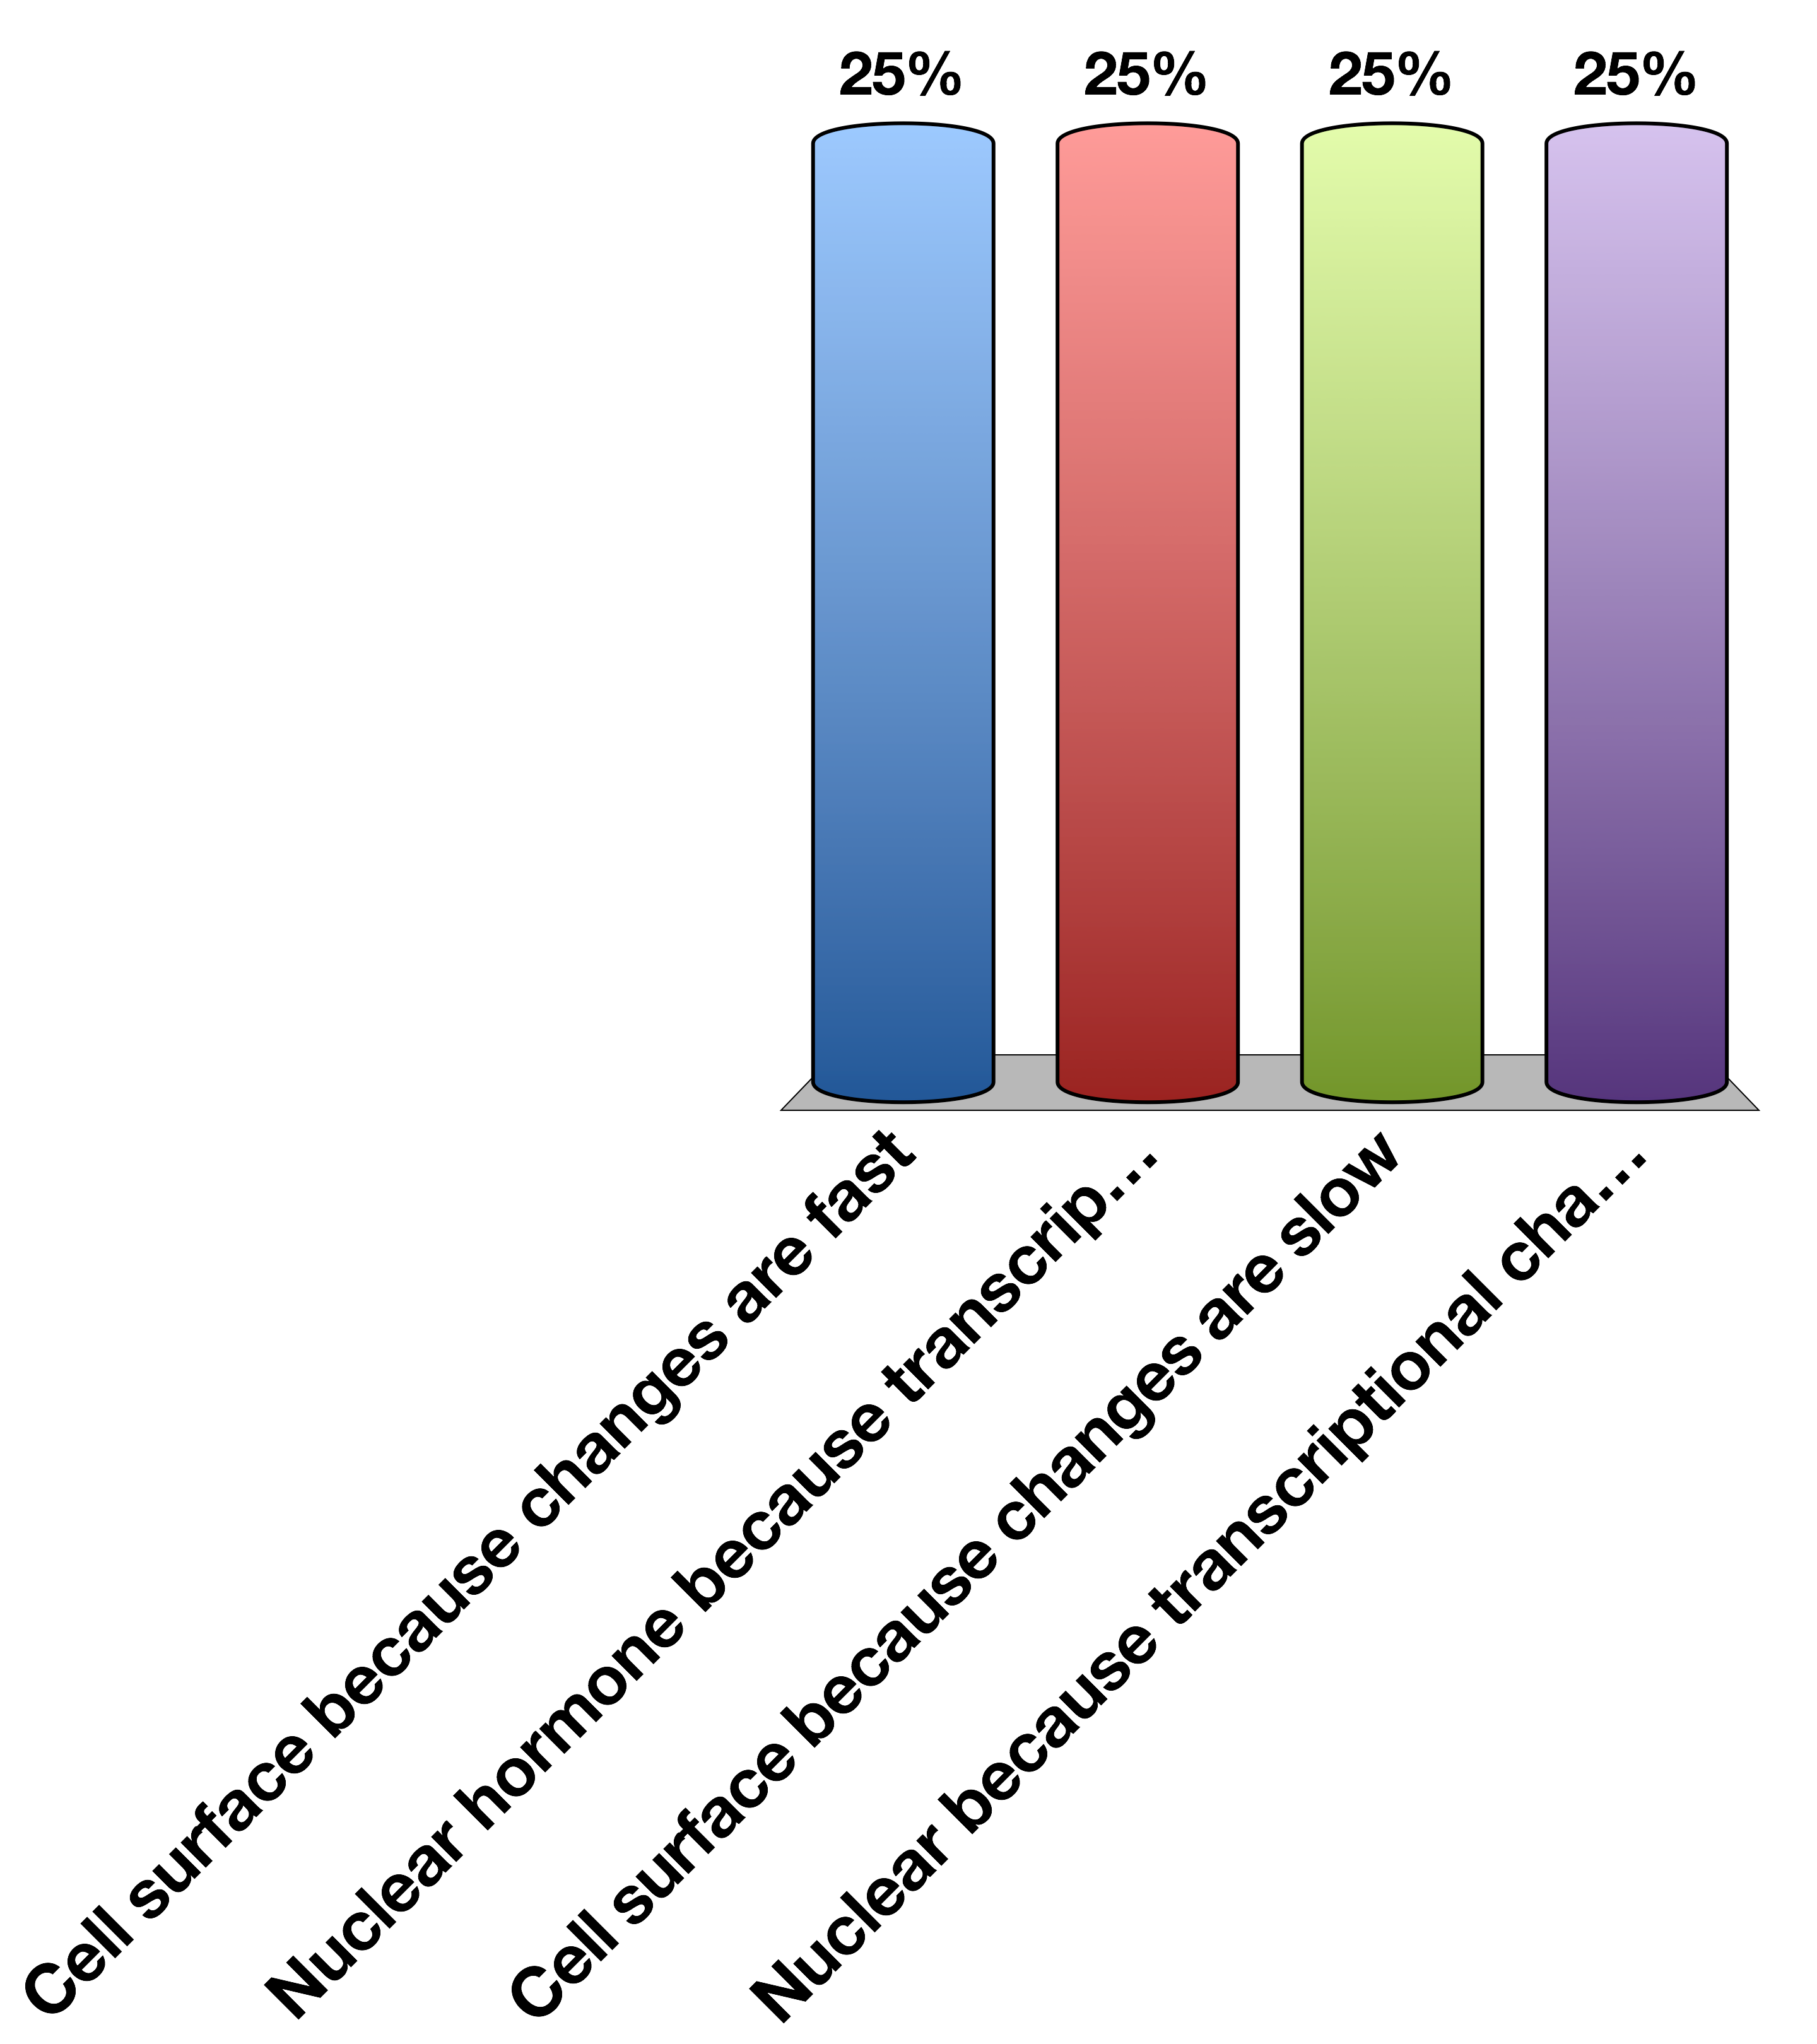
What is the most likely receptor?
Cell surface because changes are fast
Nuclear hormone because transcriptional changes are fast
Cell surface because changes are slow
Nuclear because transcriptional changes are slow
15

Slide 54
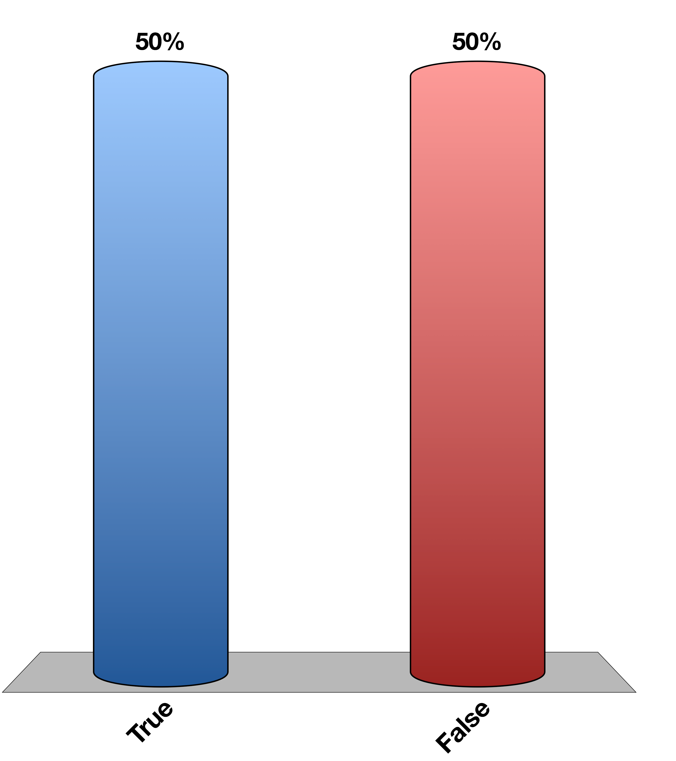
Is there a neuroendocrine component?
True
False
15

Slide 55
Neuroendocrinology and the Posterior Pituitary

Slide 56
Learning Objectives
Recall anatomical, biochemical, and functional evidence showing intimate relationships between hypothalamus and pituitary.
Describe how hormones are sensed by the neurons of the hypothalamus, and the role that the blood brain barrier and transport mechanisms play.
Recall how the central nervous system can integrate with the hypothalamus and modify both hormonal secretions and executive function.
Describe the differences in how hypothalamic signals are passed to the posterior and anterior pituitary glands.
List the known hypothalamic hormones which cause release (and release-inhibition) of anterior pituitary hormones, including their acronymns.
Name two major posterior pituitary hormones, their chemical category, and succinctly describe their secretory mechanism.
Describe cellular actions of vasopressin in terms of site of actions, receptors, and cellular signals.
Discuss briefly aquaporin water channels and relation to vasopressin.
Predict what the changes are expected in urine volume and osmolality and in ECF volume when vasopressin synthesis or secretion is severely impaired. Predict what will happen to water intake. Explain why there can be transient diabetes insipidus following a whiplash injury, and the rationale for therapy during this time.
Describe the control of vasopressin release.
Describe the function of oxytocin with respect to delivery and lactation.

Slide 57
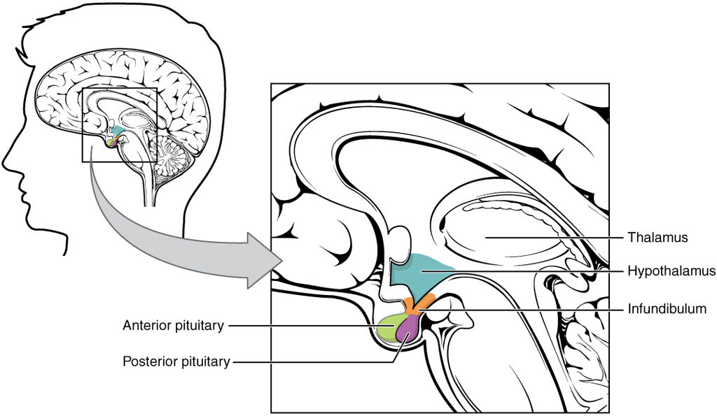
The Hypothalamus Is the Main Site of Endocrine/CNS Integration

Slide 58
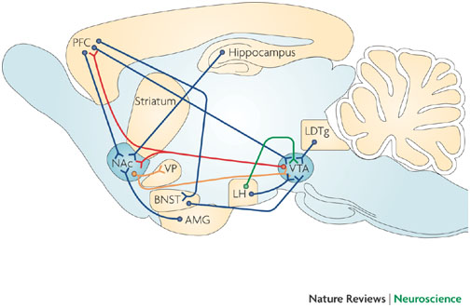
The Hypothalamus Projects to and From Other Brain Regions
Kauer JA, Malenka RC (2007) Synaptic plasticity and addiction. Nat Rev Neurosci 8: 844–858. doi:10.1038/nrn2234.
Notes:
What are some examples of why blood hormone levels might want to be passed along to other brain regions. How about why the brain might want to affect hypothalamic processes
LH is lateral hypothalamus
VTA is in midbrain
AMG is amygdala
PFC is prefromtal cortex

Slide 59
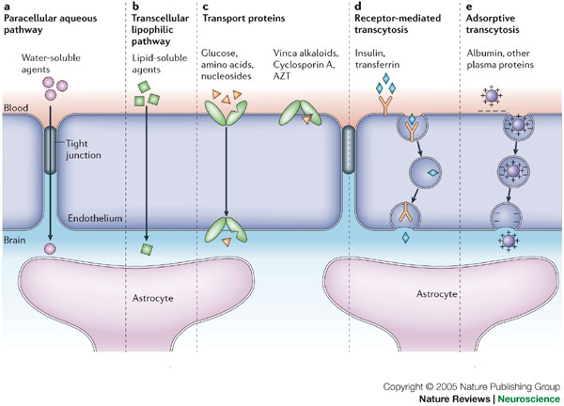
How Are Hormones Sensed by the Hypothalamus?
Notes:
Semi-permeable blood brain barrier.
Mention when transport is required, this can be another step in hormonal regulation

Slide 60
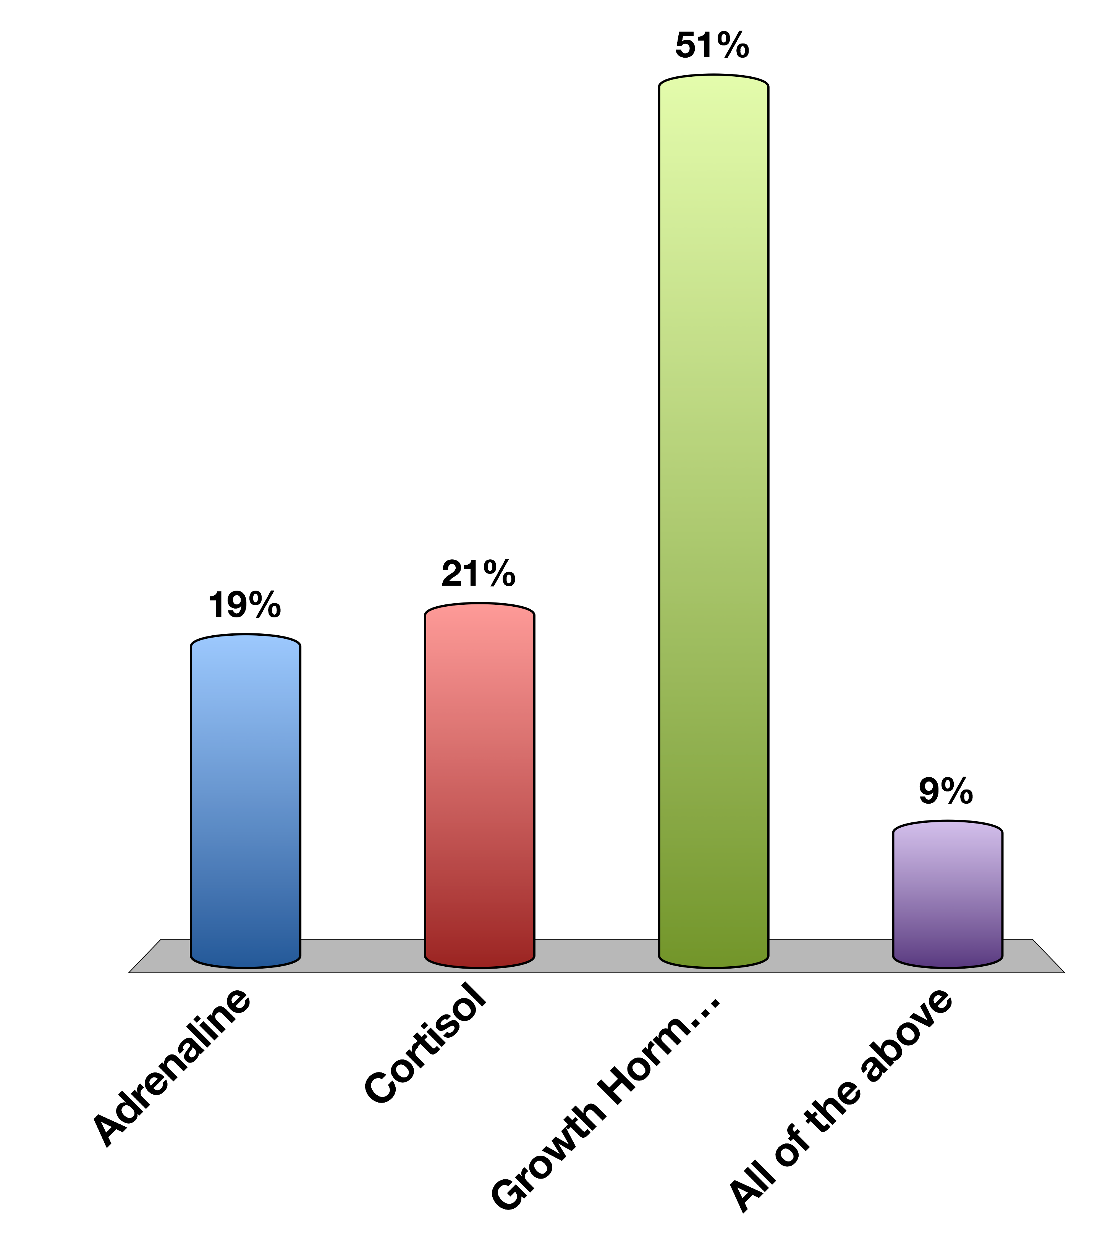
Which hormone is unlikely to be BBB-permeable without transport
Adrenaline
Cortisol
Growth Hormone
All of the above
0

Slide 61
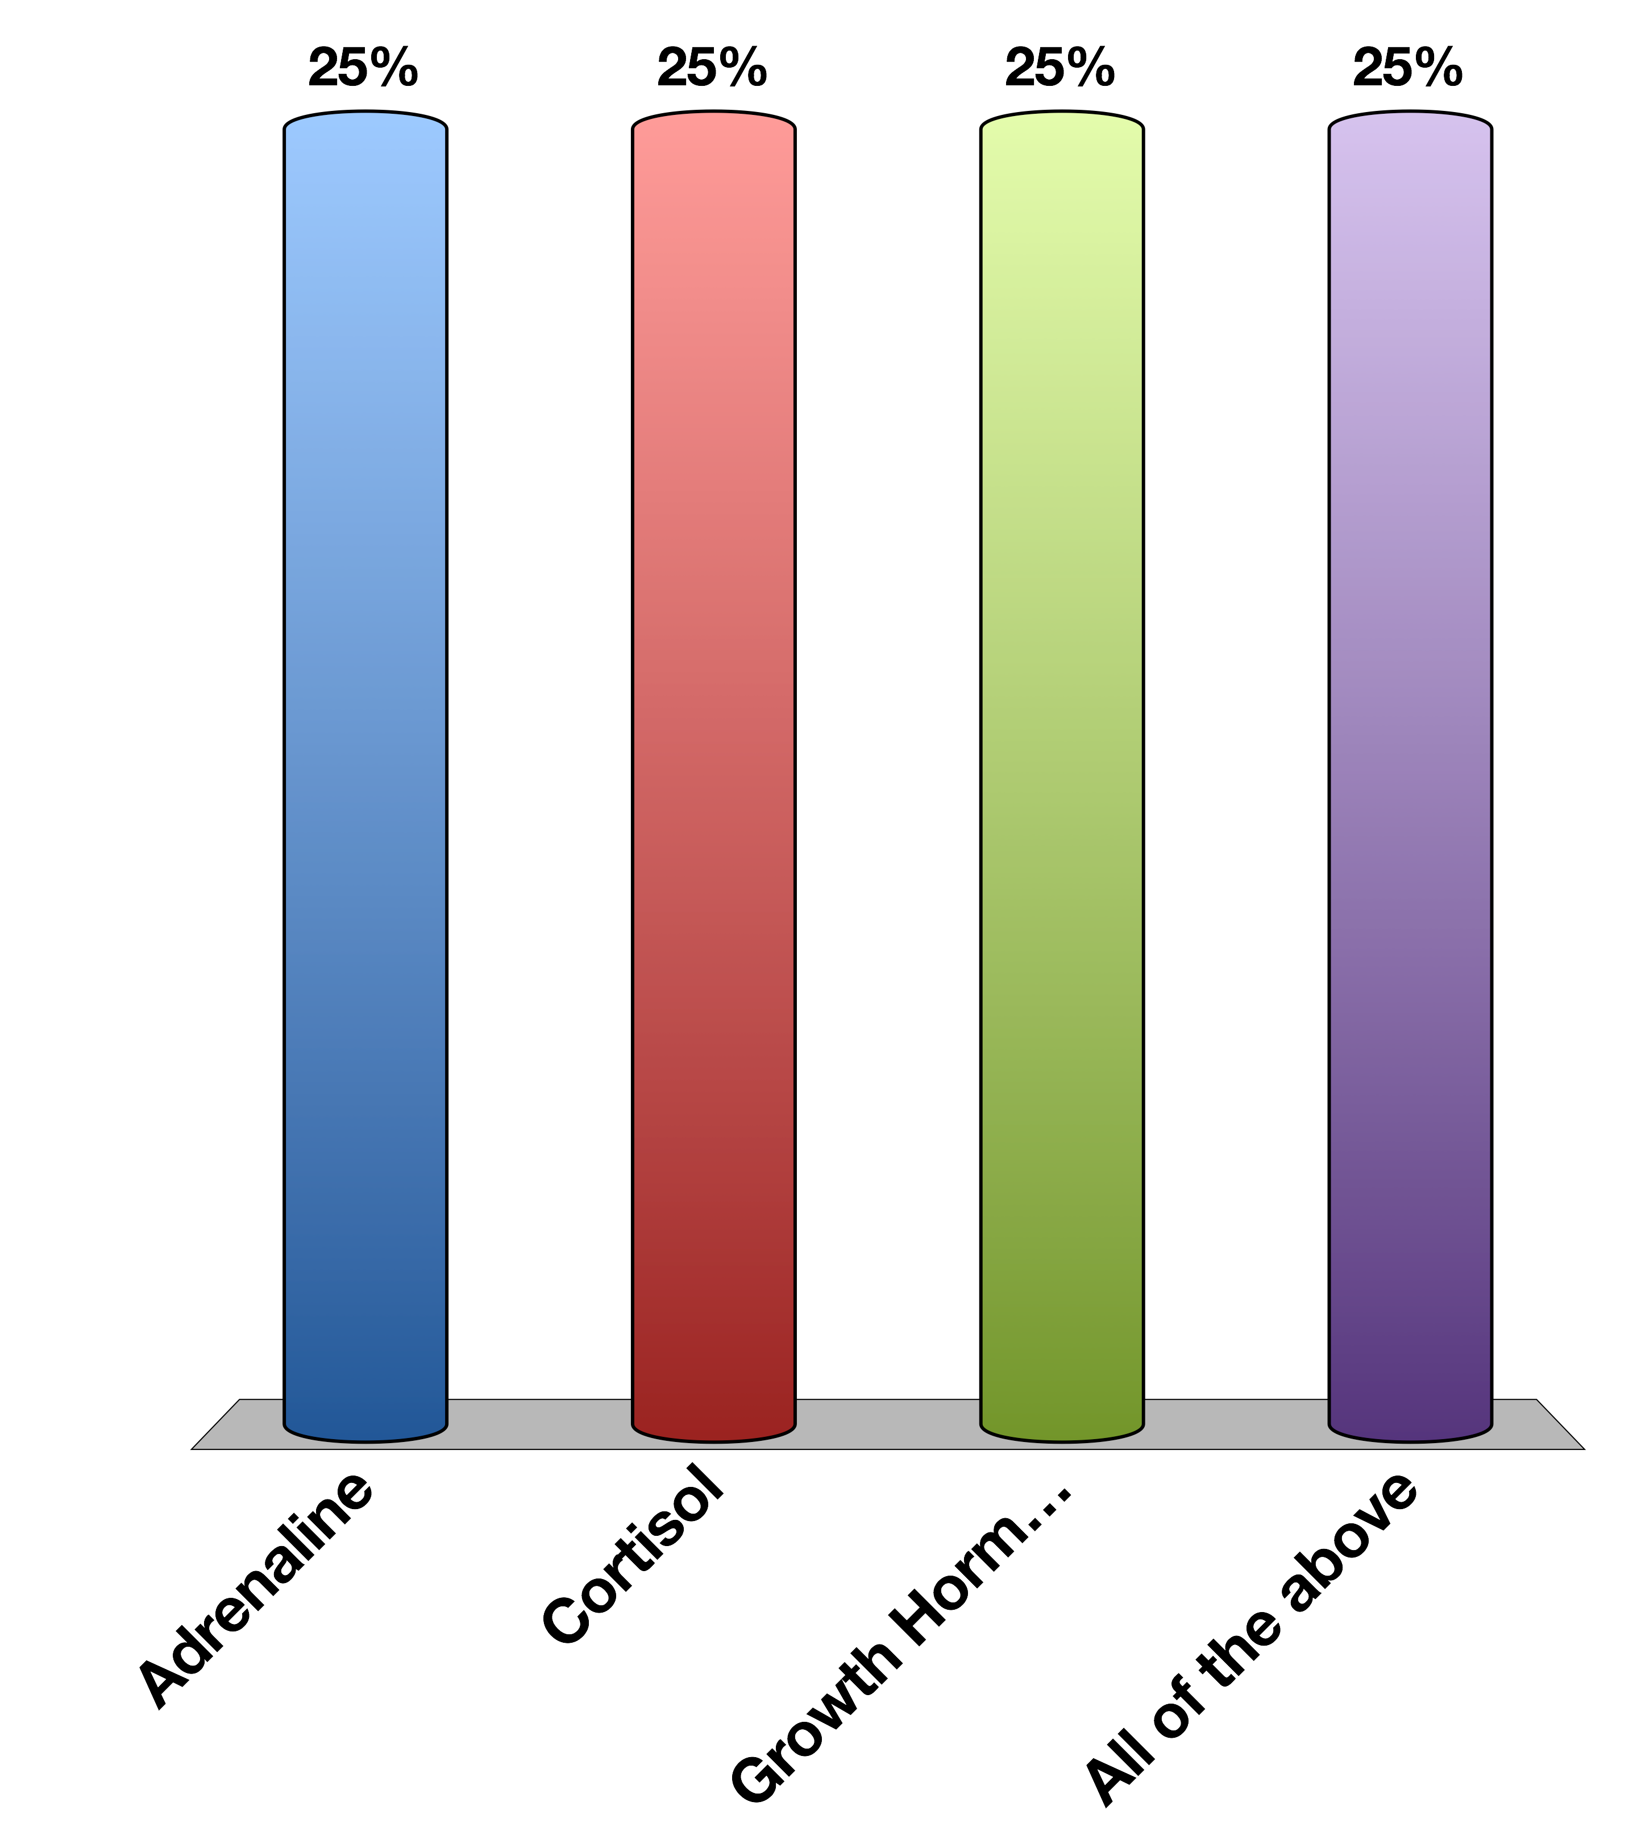
Which hormone is unlikely to be BBB-permeable without transport
Adrenaline
Cortisol
Growth Hormone
All of the above
15

Slide 62
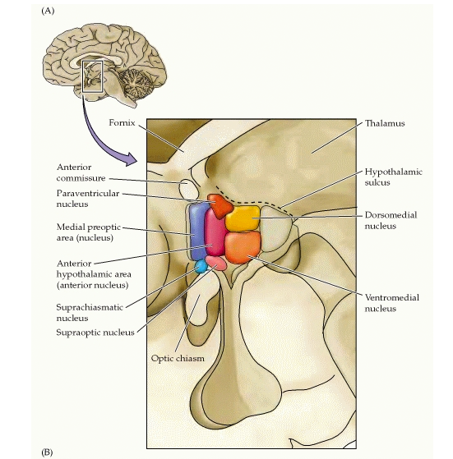
Subregions of the Hypothalamus
Notes:
Each of these regulates different processes
Mention how there is no way for endocrine secretion within the hypothalamus

Slide 63
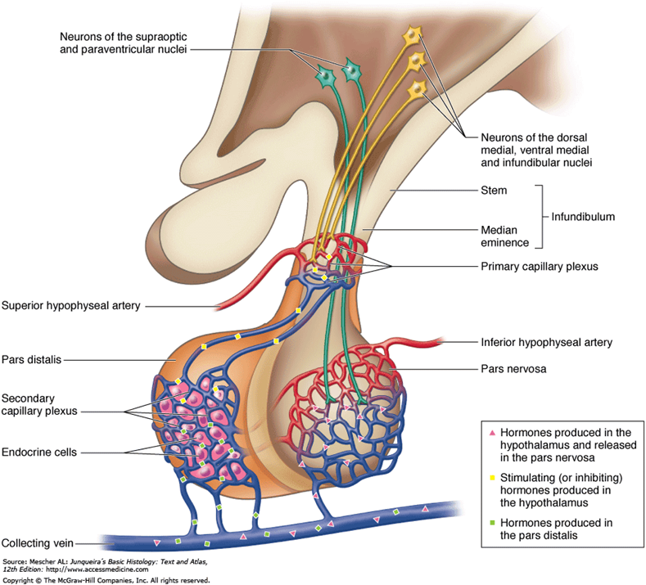
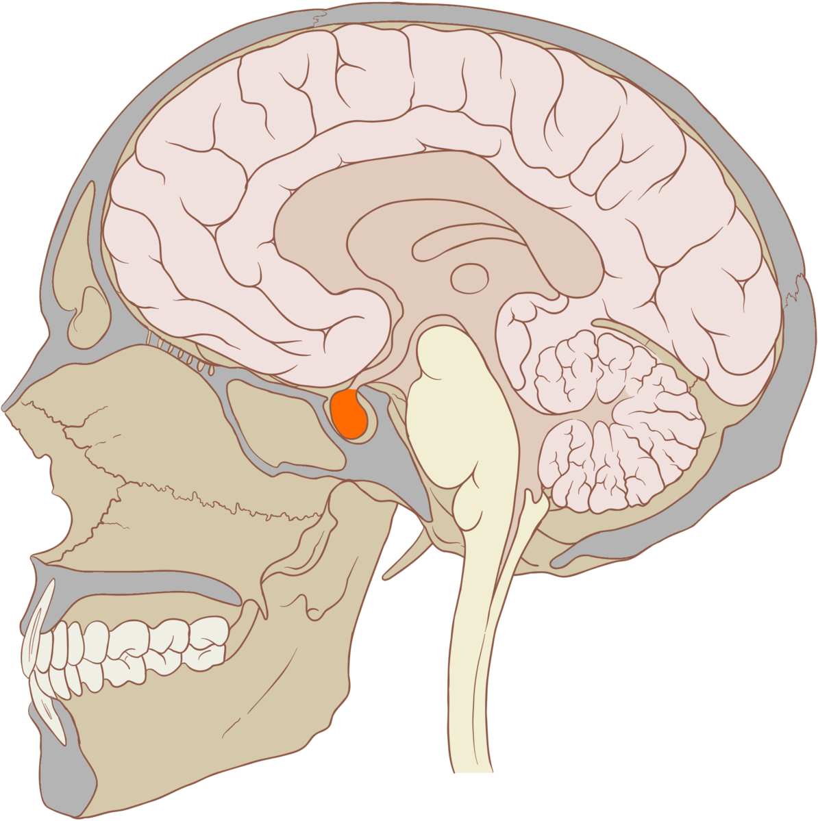
Anatomy of the Pituitary
Neurohypophysial
Portal System
Posterior
Pituitary
Anterior
Pituitary
Notes:
Anterior pituitary is connected to the hypothalamus by capilaries called the hypophyseal portal system
Posterior pituitary is connected to the hypothalamus by neurons
Both can secrete hormones directly into the circulation

Slide 64
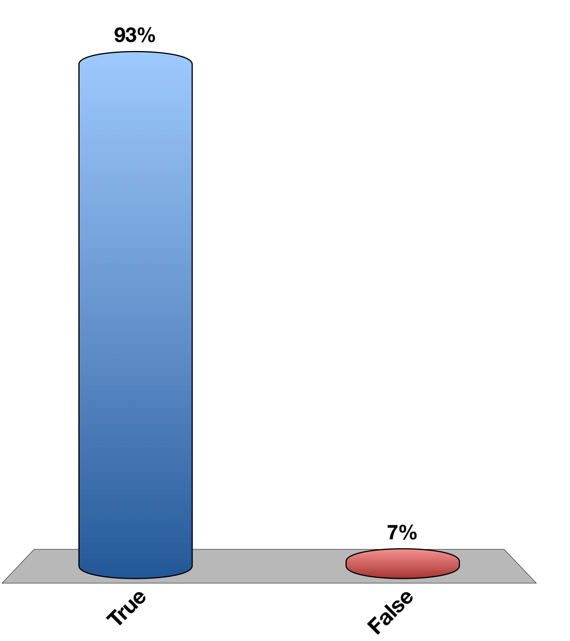
The posterior pituitary is connected to the hypothalamus by direct neuronal contacts
True
False
0

Slide 65
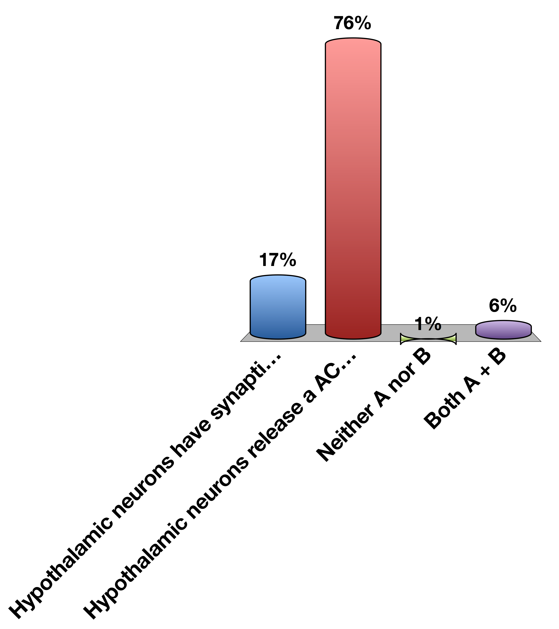
The hypothalamus wants to tell the anterior pituitary to secrete ACTH. How would this be done
Hypothalamic neurons have synaptic contacts with ACTH releasing cells
Hypothalamic neurons release a ACTH-releasing hormone
Neither A nor B
Both A + B
0

Slide 66

The hypothalamus wants to tell the anterior pituitary to secrete ACTH. How would this be done
Hypothalamic neurons have synaptic contacts with ACTH releasing cells
Hypothalamic neurons release a ACTH-releasing hormone
Neither A nor B
Both A + B
15

Slide 67
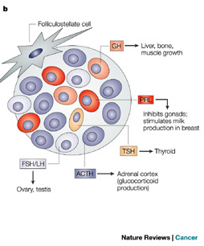
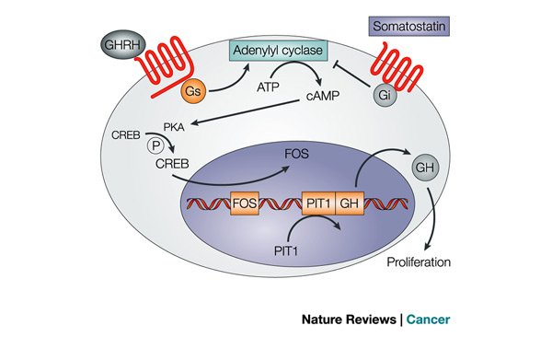
Anterior Pituitary
Hypothalamic | Anterior Pituitary | Cells
CRH | ACTH | Corticotropes
TRH | TSH/Prolactin | Thyrotropes/ Lactotropes
GnRH | LH/FSH | Gonadotropes
GHRH | GH (increase) | Somatotropes
Somatostatin | GH (decrease) | Somatotropes
Asa SL, Ezzat S (2009) The pathogenesis of pituitary tumors. Annu Rev Pathol 4: 97–126. doi:10.1146/annurev.pathol.4.110807.092259.
Notes:
Each cell type is responsible for a particular kind of hormone secretion
Mention all GPCRs

Slide 68
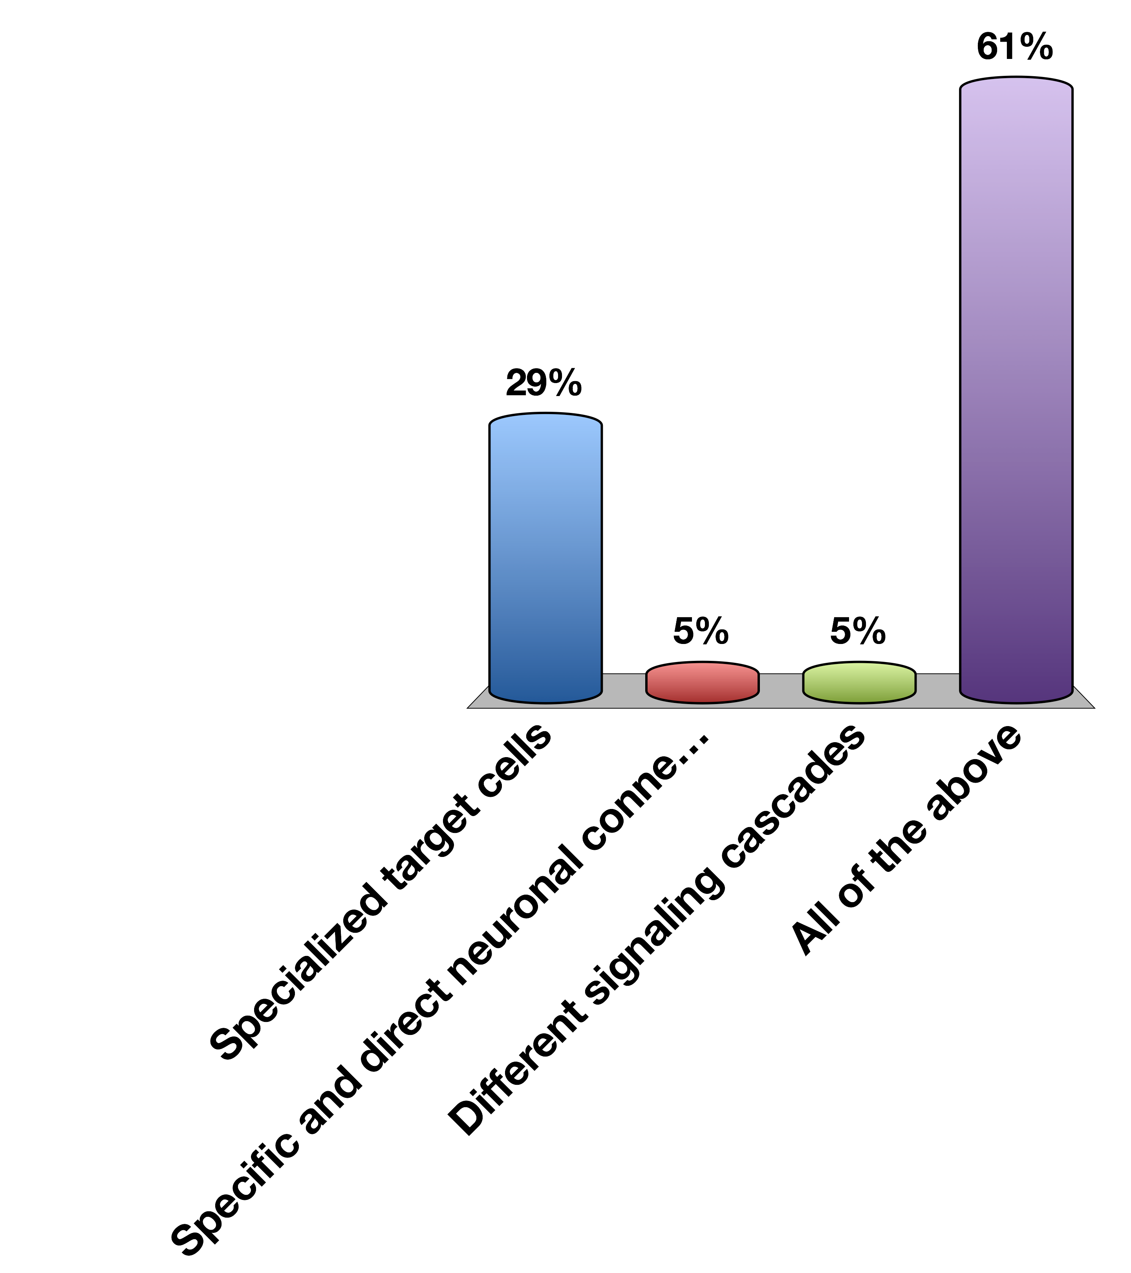
How Is Specificity Achieved in Hypothalamlic-Anterior Pituitary Signaling
Specialized target cells
Specific and direct neuronal connections
Different signaling cascades
All of the above

Slide 69

How Is Specificity Achieved in Hypothalamlic-Anterior Pituitary Signaling
Specialized target cells
Specific and direct neuronal connections
Different signaling cascades
All of the above

Slide 70

The Infundibulum and the Posterior Pituitary
Notes:
ADH is vasopressin

Slide 71
Why Regulate Water Retention?
Too much or too little blood volume
Salt concentration in blood is too high or too low

Slide 72
Vasopressin
What chemical type? | Peptide | 9 Amino acids
Where is it made? | Posterior Pituitary
What causes its release? | Hypothalamic osmoreceptors (PVN/SFO) and Mechanoreceptors (Carotid artery) | Increased osmotic pressure or reduced plasma volume
What are its receptors? | AVPR1-3 | GPCR (Gs)
What tissues does it affect? | Kidney (Collecting Ducts) | Water Reuptake (AQP2 trafficking)
 | Vascular System | Vasoconstriction
 | Anterior Pituitary | ACTH Release
How does it get turned off? | Normalization of volume/osmolality and AVPR receptor desensitization (arrestins)/vasopressinase

Slide 73

Vasopressin Release

Slide 74
Volume, Osmolality and Vasopressin
Vasopressin is released due to decreased blood volume or increased salt concentration
Decreased blood volume is detected by mechanoreceptors at the carotid sinus
Increased salt concentration is detected by osmoreceptors in the SFO and hypothalamus
In either case, the hormone dilutes the blood by retaining water.

Slide 75


Baroreceptor Regulation of Vasopressin Release

Slide 76

The carotid sinus senses increased blood volume due to drinking too much water…
Vasopressin is released
Vasopressin release is inhibited
The carotid sinus cant sense blood volume
More water is retained

Slide 77

If vasopressin release is activated by ethanol, this would cause increased urination
True
False
Notes:
False because more vasopressin would mean more water retention

Slide 78


Osmoreceptor Regulation of Vasopressin Release

Slide 79

Aldosterone and vasopressin…
Both increase blood sodium concentration
Both decrease blood sodium concentration
Vasopressin reduces blood salt concentration, aldosterone increases it
Vasopressin increases blood sodium, aldosterone decreases it
Notes:
Aldosterone promotes salt reuptake, vasopressin promotes water reuptake

Slide 80
Aldosterone and vasopressin…
Both increase blood sodium concentration
Both decrease blood sodium concentration
Vasopressin reduces blood salt concentration, aldosterone increases it
Vasopressin increases blood sodium, aldosterone decreases it
Notes:
Aldosterone promotes salt reuptake, vasopressin promotes water reuptake

Slide 81

Vasopressin Regulates Aquaporin Trafficking

Slide 82

Effects of Vasopressin on the Kidney
Collecting
Tubules
Blood
Notes:
Ask if water can normally cross the collecting duct membrane
Why does water travel this way and not that way

Slide 83
Conditions with Altered Vasopressin Function
Lack of vasopressin signaling
Hypernatria
Diabetes insipidus
Too much vasopressin signaling
Hyponatria
Headache, nausea, hypertension
Notes:
Not enough, can cause hypernatria, diabetes insipidus. This isnt to be confused with diabetes mellitus, but both were named due to excessive urination
This is because not enough water is pulled back in from the urine
What could cause a lack of vasopressin signaling? Should be less secretion of vasopressin, or could be less receptor signaling, or could be increased vasopressinase (gestational)

Slide 84
Discuss with Folks Nearby
How could whiplash cause diabetes insipidus?
HINT: Relates to damage/severing of infundibulum
Notes:
Severed pituitary stalk -> low vasopressin -> low water reabsorbtion -> diabetes insipidus

Slide 85
Oxytocin Summary
What chemical type | Peptide
Where is it made? | Posterior Pituitary
What causes its release? | Synaptic activation in Hypothalamus (PVN, mechanism unclear)
What are its receptors? | OXTR
What tissues does it affect? | Uterus | Contractions
 | Mammary Glands | Let-Down Reflex (Lactation)
 | Neural | Positive Social Interactions
How does it get turned off? | Delivery (reduced input)

Slide 86

Oxytocin During Delivery
Notes:
Mention as there are cotnractions, that induces more oxytocin release.
This is a positive feedback loop

Slide 87

Oxytocin During Lactation

Slide 88
Learning Objectives
Recall anatomical, biochemical, and functional evidence showing intimate relationships between hypothalamus and pituitary.
Describe how hormones are sensed by the neurons of the hypothalamus, and the role that the blood brain barrier and transport mechanisms play.
Recall how the central nervous system can integrate with the hypothalamus and modify both hormonal secretions and executive function.
Describe the differences in how hypothalamic signals are passed to the posterior and anterior pituitary glands.
List the known hypothalamic hormones which cause release (and release-inhibition) of anterior pituitary hormones, including their acronymns.
Name two major posterior pituitary hormones, their chemical category, and succinctly describe their secretory mechanism.
Describe cellular actions of vasopressin in terms of site of actions, receptors, and cellular signals.
Discuss briefly aquaporin water channels and relation to vasopressin.
Predict what the changes are expected in urine volume and osmolality and in ECF volume when vasopressin synthesis or secretion is severely impaired. Predict what will happen to water intake. Explain why there can be transient diabetes insipidus following a whiplash injury, and the rationale for therapy during this time.
Describe the control of vasopressin release.
Describe the function of oxytocin with respect to delivery and lactation.

Slide 89
Your Future
Endocrine Control Systems
Neuroendocrinology and the Posterior Pituitary
Endocrine Control of Growth
Adrenals and Stress Hormones
Hypothalamus and Endocrine Control of Appetite
Pancreatic Hormones and Metabolic Control
Thyroid Hormones (KP)
Calcium Homeostasis (MF)
Reproductive Hormones (HP)

Slide 90
The End

